Slide 1
Utility data submission portal (UDSP)
Public Workshop
6/30/2026
Clayton Strawn
Research Data Supervisor II
Data Analytics Division
Office of Energy Infrastructure Safety

Slide 2
OVERVIEW
Energy Safety has created a new self-service Web submission portal for annual and quarterly nonspatial data
We will talk about creating accounts, the UAT process, and future requirements with the portal

Slide 3
Utility Data Submission Portal (UDSP)
New self-service submission method
Web-based interface where electrical corporation users:
  Submit their Quarterly, Annual-WMP, Annual-EOY, and Revisions files
  Receive immediate validation and rejection for basic errors (datatypes, filenames, missing values)
    Receive detailed error report with instructions to fix
  May resubmit as many times as necessary until data passes validation. Validated file is approved or denied by a human user at Energy Safety.
  On approval, automatically publish approved file to E-Filing.

Slide 4
Utility Data Submission Portal (UDSP)
The UDSP is NOT:
  A replacement for E-Filing. E-Filing will still store data and make it public. UDSP will do neither.
  A portal for non-data submissions (DRs, WMPs, PDFs such as data status reports). Only well-structured data submissions following the Data Guidelines.
  A spatial data validation tool.

Slide 5
Basic process

Slide 6
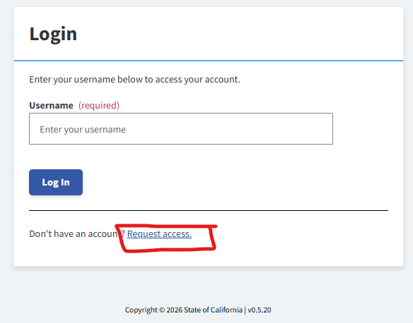
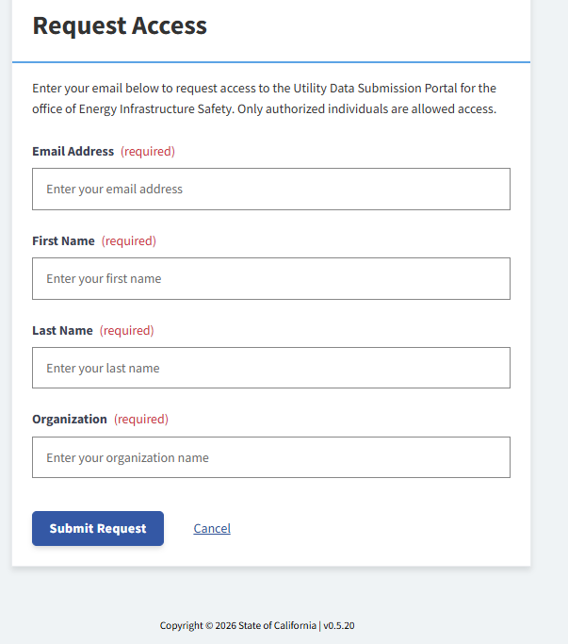
Basic udsp workflow
Step 1: Create Account (1 of 2)
  Click “Request Access” on login page
  Fill in contact details, including which utility you are with
  Submit Request
  Click link in email sent to you to validate email address
  Wait for Energy Safety staff to approve

Slide 7
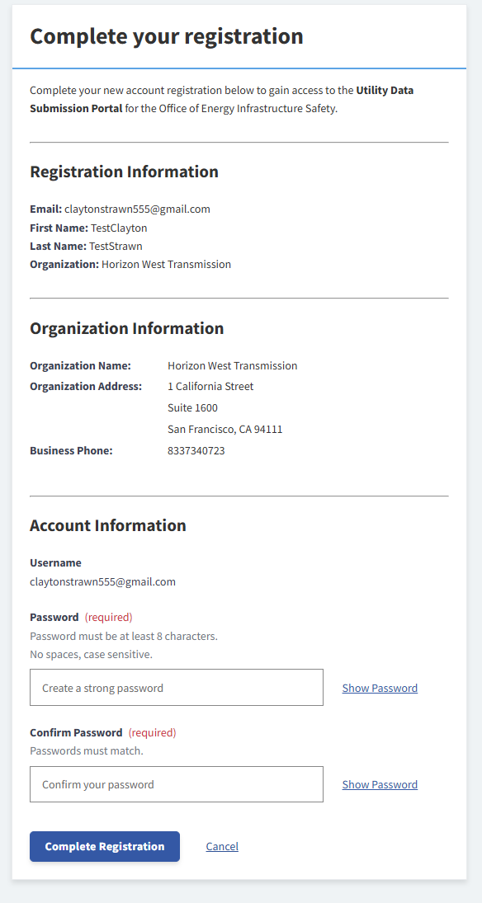
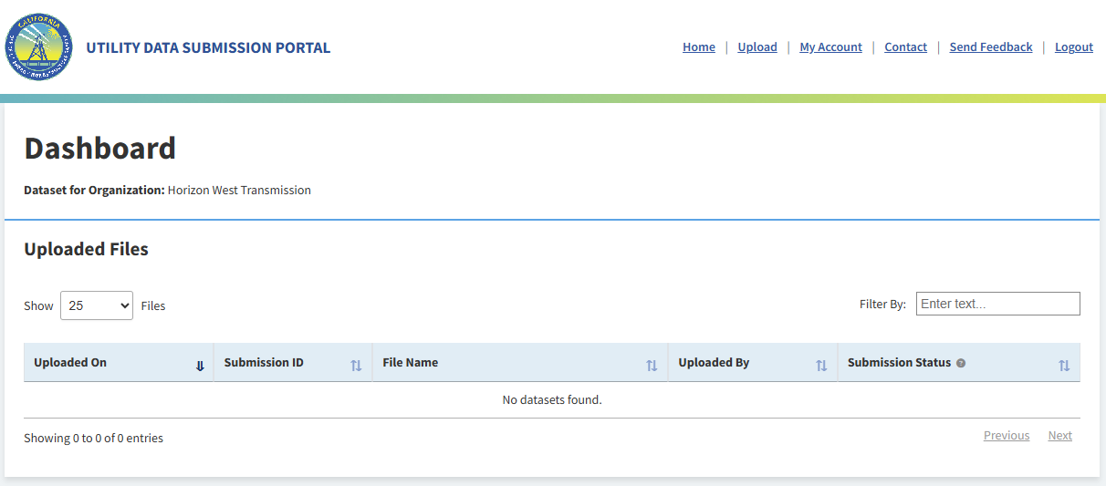
Basic udsp workflow
Step 1: Create Account (2 of 2)
  When approved by Energy Safety, click link in approval email
  Confirm organization details and create password
  Log in to the portal using your username and password

Slide 8
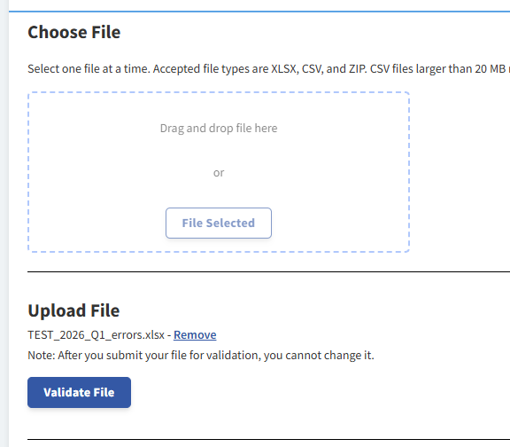
Basic udsp workflow
Step 2: Upload files
  Go to the “Upload” tab
  Choose a tabular data submission on your computer (required filename + format following DGs v4.1)
    ECNAME_YYYY_QX.xlsx
    ECNAME_YYYY_EOY.xlsx
    ECNAME_WMP_YYYYX#R#.xlsx
    ECNAME_Revisions_R#.xlsx
  Upload in the box
  “Validate File”

Slide 9
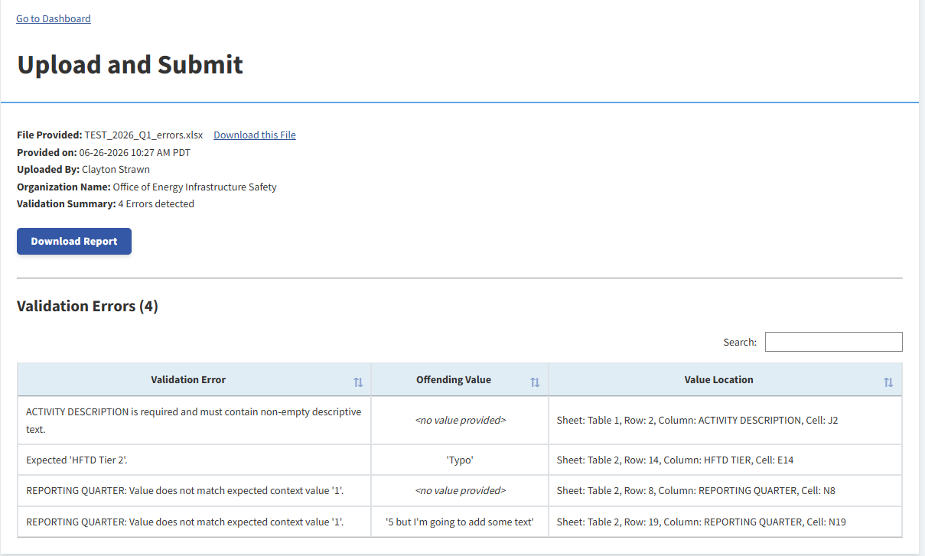
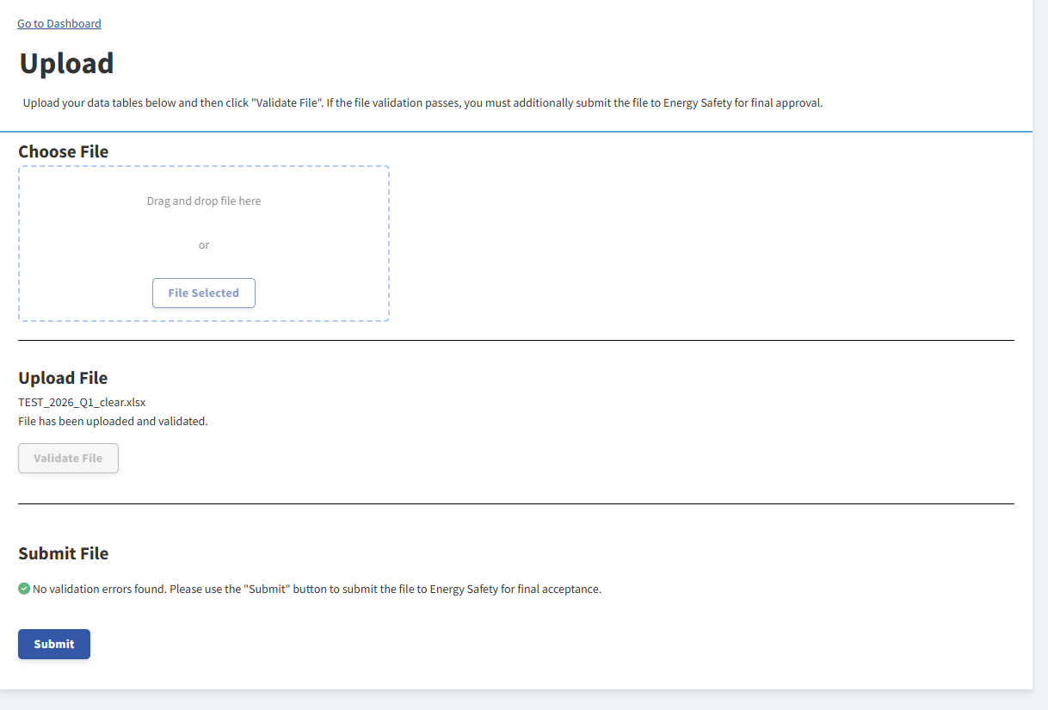
Basic udsp workflow
Step 3: Pass Validation
  If your file does not pass validation, you will be directed to “error report” screen listing all errors
    Can download error report for offline use with “Download Report” button
  Keep uploading files until one passes validation
  Click “Submit” to send to Energy Safety

Slide 10
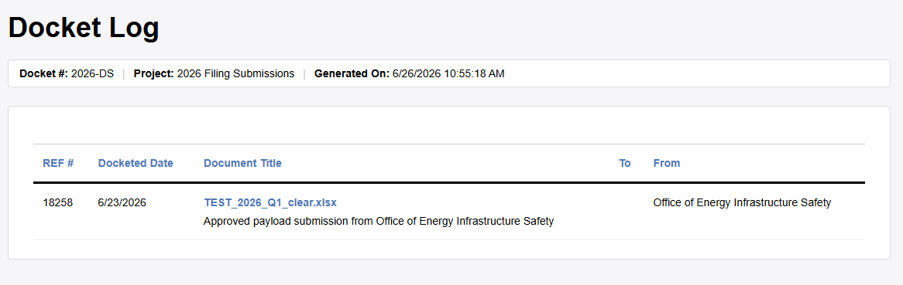
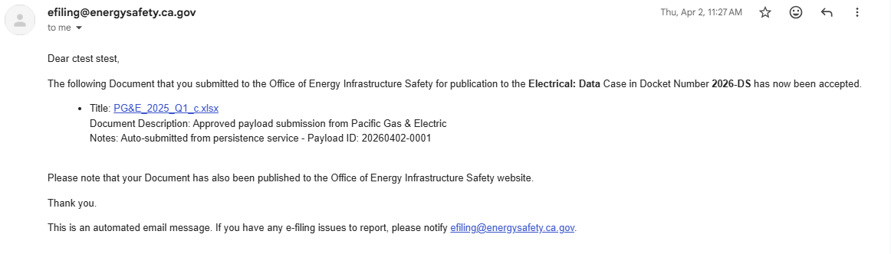
Basic udsp workflow
Step 4: Energy Safety Approval
  Energy Safety will approve or reject your file from within the portal
  If rejected, will include instructions for resubmission (non-automated validation issues)
  If approved, file directly passes to E-filing, no further action needed.
    Email notification will be sent

Slide 11
UDSP DEMO

Slide 13
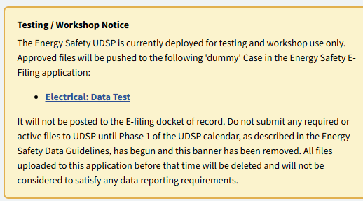
User Accessibility Testing (UAT)
We are opening up the UDSP for all utilities to create accounts and begin testing.
This docket contains some generic test files you can use, or upload your own real or edited files

Slide 14

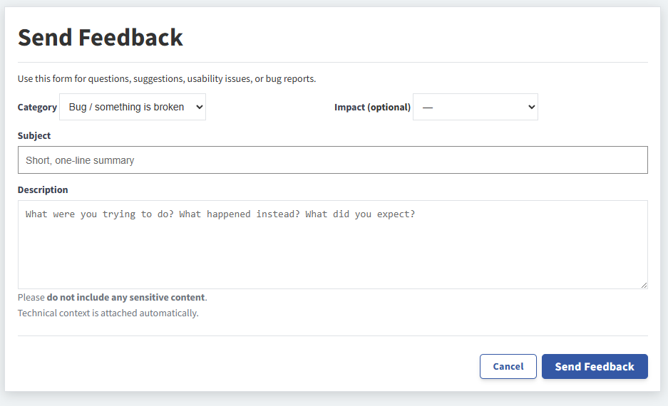
User Accessibility Testing (UAT)
Use the “Send feedback” button to make comments to Energy Safety on incorrect behavior, confusing design, or any other comments or questions.
We will reply to your comments and
update the site

Slide 15
User Accessibility Testing (UAT)
UAT will end about a week before Q2 data submission due date (Aug 1, 2026)
We will redirect the UDSP to send submissions to the correct “Electrical: Data” case on E-filing.
  All data sent to “Electrical: Data Test” will be deleted at this time.
  All utilities will be notified via email

Slide 16
Public Comment or Question Period
UDSP link: https://udsp.energysafety.ca.gov

Slide 17
contact
Please send any additional questions or comments on UDSP to clayton.strawn@energysafety.ca.gov
  To remove existing users after they leave the organization, please send an email to the address above.

Slide 19
SCREENSHOTS FOR LATER REFERENCE

Slide 20
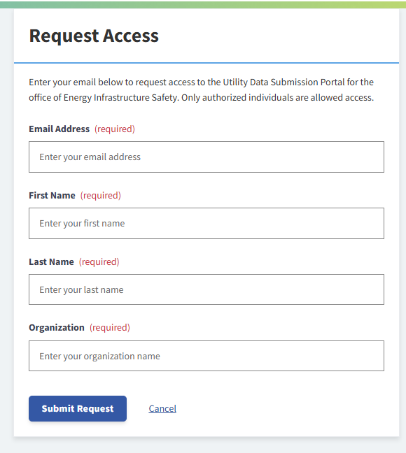
Request Access Page

Slide 21
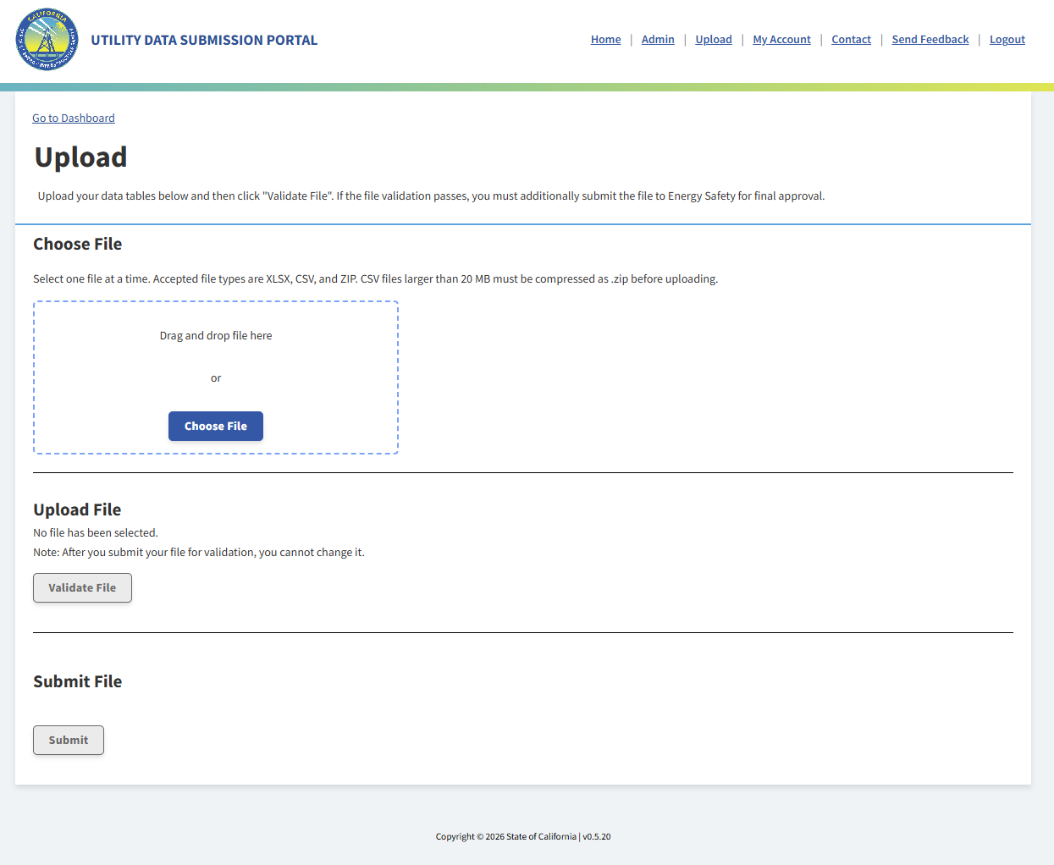
File Upload Page

Slide 22
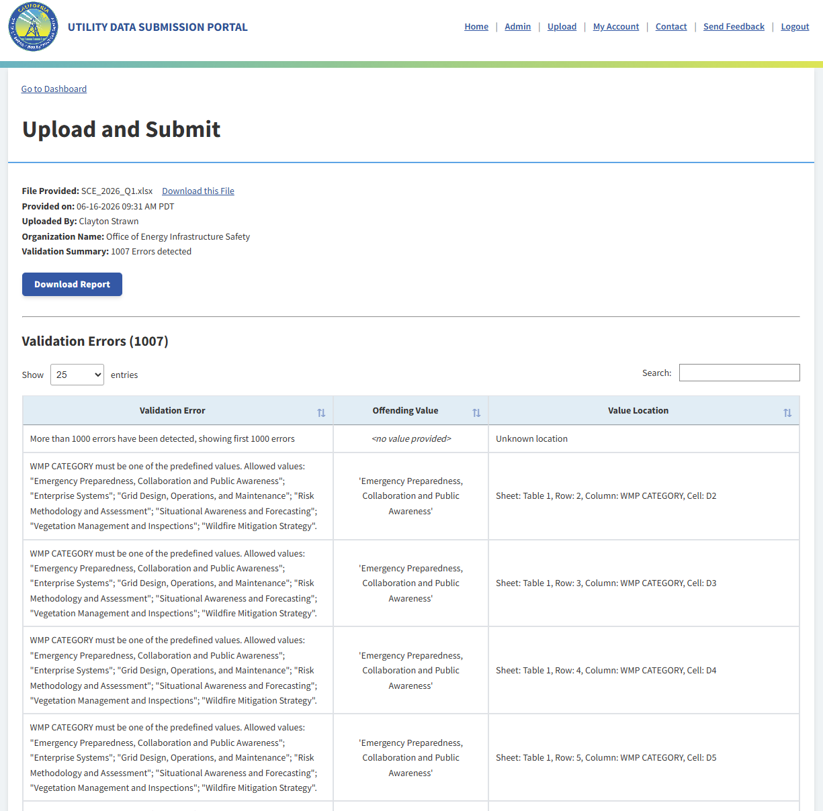
Validation Errors Page
(After Upload + click Validate)

Slide 23
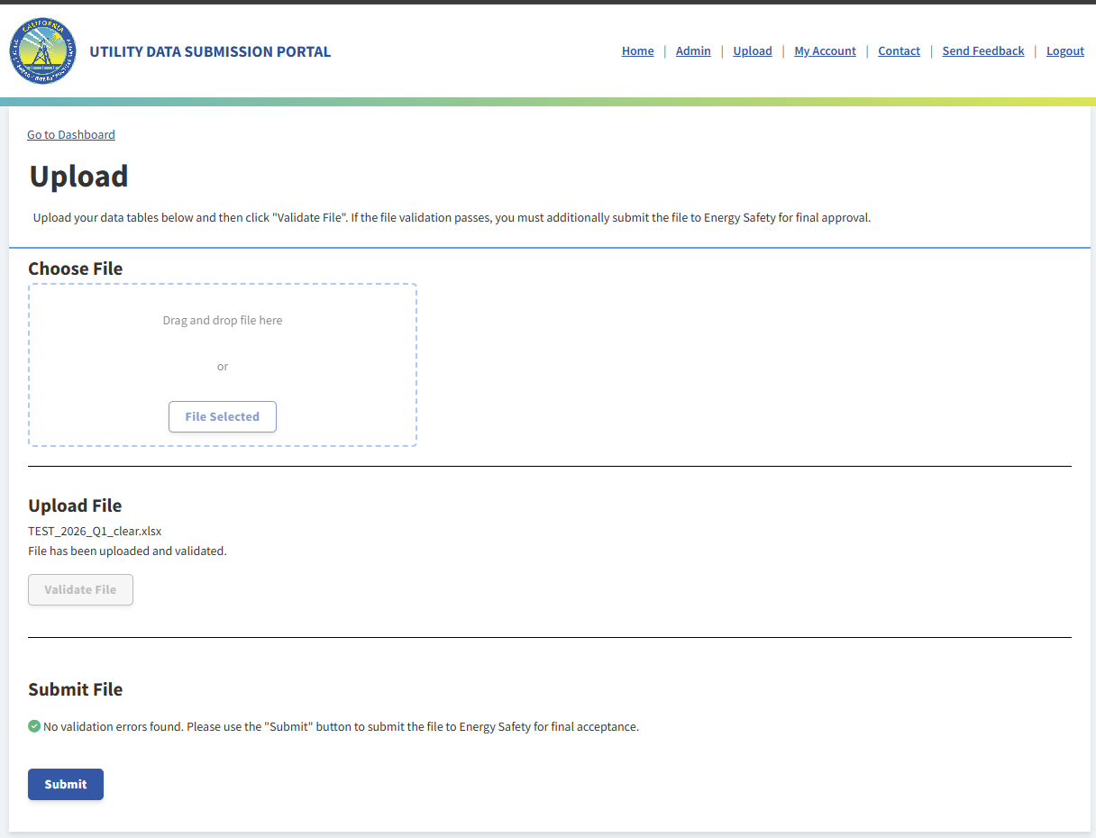
Validation Pass
(After Upload + click Validate and no errors)

Slide 24
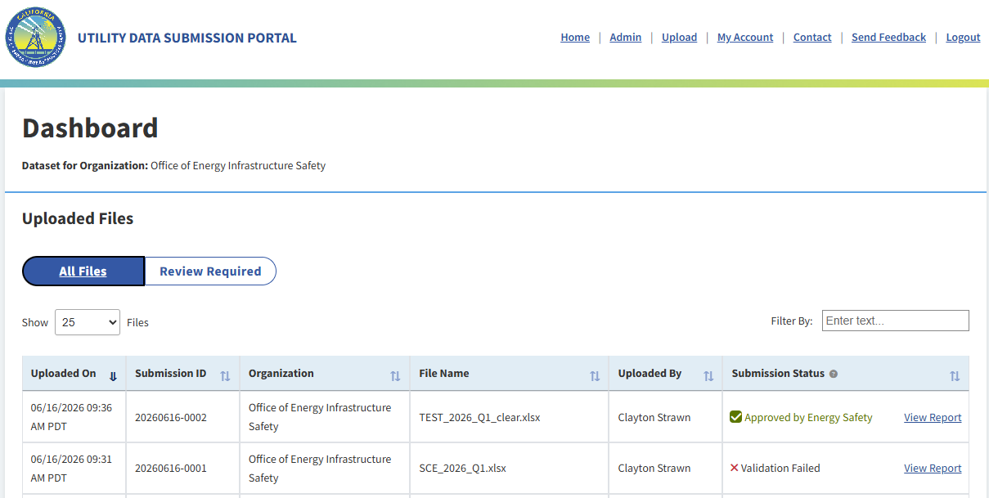
Dashboard
Shows all files uploaded and current status.
Automatically removes validation fails after approved file passed to Efiling

