Slide 1
EPSS Risk Model

Slide 2
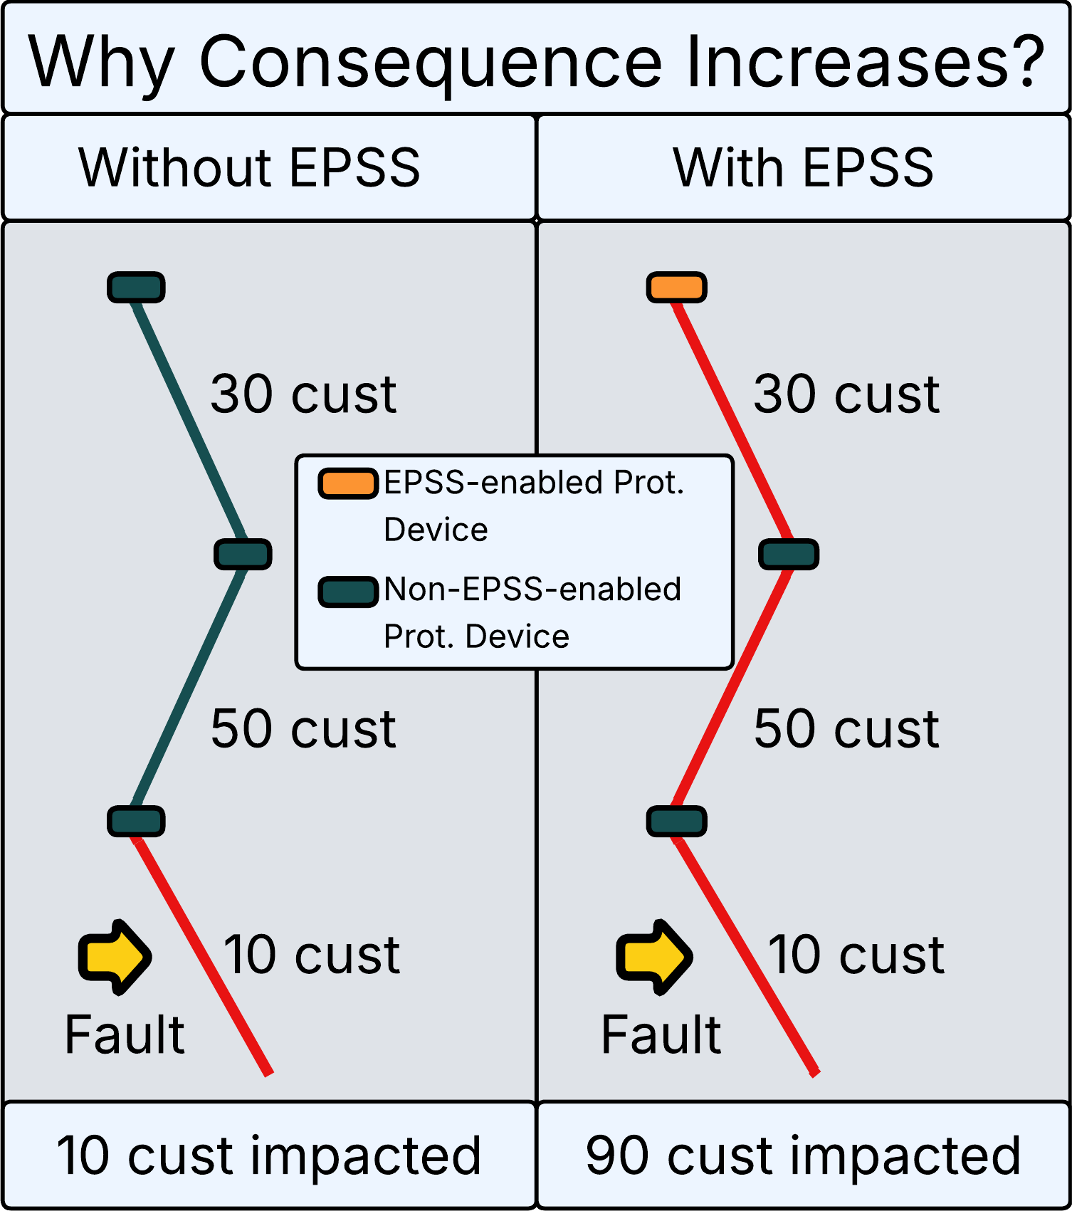
EPSS Model Overview 1/2
1
Enabling EPSS increases outage risk to improve safety, by converting momentary outages into sustained outages, and by impacting more customers per outage.
Incremental Sustained Outage Risk from EPSS enablement
EPSS
disabled enabled
Consequence ($/outage-minute)
Baseline Sustained Outage Risk
Likelihood (outage-minutes/year)
disabled enabled
EPSS
Why Consequence Increases? Nearest upstream EPSS-enabled protective device farther upstream than nearest non-EPSS-enabled protective device → more customers impacted
Why Likelihood Increases? EPSS disables auto-reclosing → momentary outages become sustained → more outage-minutes

Slide 3
EPSS Model Overview 2/2
1
Outage Risk is the likelihood of an outage and the expected consequences of an outage occurring. This quantifies the business cost associated with sustained outages.
WDRM v4 p(f) = Probability of sustained outage when EPSS enabled
Expected Duration
(minutes)
Customers Impacted
(downstream of EPSS)
Value of Service
($ per customer minute)
Outage Risk when EPSS is Enabled
($)
WDRM v4 p(f) * Sustained Outage Fraction = Probability of sustained outage when EPSS disabled
Expected Duration
(minutes)
Customers Impacted
(outage only)
Value of Service
($ per customer minute)
Baseline Sustained Outage Risk
($)
Outage Likelihood
Outage Consequence
Expected number of outage minutes per year
Expected cost of an outage on a circuit segment
Incremental EPSS Outage Risk = Outage Risk when EPSS is Enabled − Baseline Sustained Outage Risk

Slide 4
Appendix

Slide 5
EPSS Model Data/Reference Sources
EPSS Model Data Sources:
Input | What It Provides
WDRM v4 Models | Predicted probability of failure during wildfire season across 25 failure subsets, at circuit segment and asset level
EPSS Enablement History | Historical EPSS enablement status per circuit during wildfire seasons (2017-2020, 2022-present)
EPSS Device Metrics | Customer counts downstream of each EPSS protective device and linkage of assets to nearest upstream EPSS device
SNAP Reliability Consequence | Expected outage duration per asset and customers impacted per non-EPSS outage event.
Historical Outage Data | Failure and outage records used to derive sustained outage fractions and seasonal outage multiplier
Network Topology | Isolation zone, conductor, and structure linkages mapping assets to circuit segments
Customer Service Point Attributes | Customer class and rate schedule per service point, used to classify customers for Value of Service
EPSS Reference Data:
Parameter | Source
Value of Service (VoS) | ICE 2.0 calculator, aligned with 2027 GRC. Residential = $0.08/CMI; Commercial = $23.11/CMI
Sustained Outage Fraction | Derived from PG&E historical outage data (pre-2022, non-EPSS, HFTD)
Winter/Wildfire Multiplier | Derived from PG&E historical outage data (2009-2024, HFTD)

Slide 6
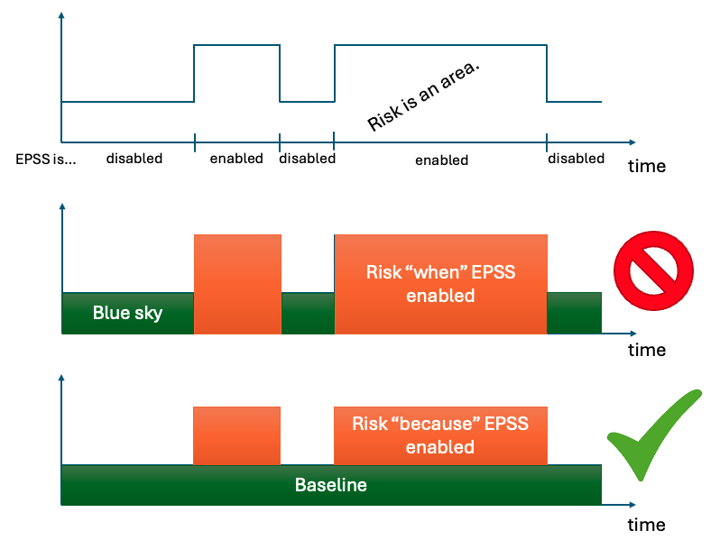
WRGSC Feb 2025 Inform –
EPSS Risk Model Overview
EPSS Reliability Risk Model
  Based on the number of unplanned EPSS-related outages 2022-2024 vs 2017-2020 baseline
  Considers which asset failed, and its upstream device, to assign the respective customers impacted downstream of the device.
Note: All models calculate consequence using the ICE CMI (customer minutes interrupted) “value of service” methodology required by the Risk Based Decision Making Framework, resulting in a monetized risk value.
Fig 1: Schematic of EPSS Model
The EPSS Reliability model calculates to the risk based on customer minutes interrupted and multiplies this by the value of service ($).
However, because EPSS devices are typically upstream from other protective devices (e.g., fuses), it is necessary to subtract out the risk from normal “blue sky” outages that would have occurred regardless of EPSS enablement.

Slide 7
EPSS Model Sample Calcs
Calcs for EPSS Model Overview
Probability of a Sustained Outage (when EPSS is enabled)
Expected Duration
(minutes)
Customers Impacted
(when EPSS is enabled)
Value of Service
($ per Customer Minute)
Outage Risk when EPSS is Enabled
($)
Probability of a Sustained Outage (full year)
Expected Duration
(minutes)
Customers Impacted
(total)
Value of Service
($ per Customer Minute)
Standard Outage Risk
($)
Component | Standard Outage Risk | Outage Risk when EPSS is Enabled
Probability of Sustained Outage | WDRM v4 PoF (wildfire season) * ~2.5 (full year) * ~0.83 (sustained only) | WDRM v4 PoF (wildfire season) * enablement rate (EPSS-on days only). No sustained correction, all outages are sustained when EPSS is on.
Expected Duration | Average minutes per sustained outage per circuit segment | SAME
Customers Impacted | Average customers impacted per outage under normal conditions | Average customers downstream of EPSS device per outage (EPSS scope -> more customers)
Value of Service | Res: $0.08, Non-Res: $23.11 per customer-minute | SAME
Incremental EPSS Outage Risk = Outage Risk when EPSS is Enabled − Standard Outage Risk

Slide 8
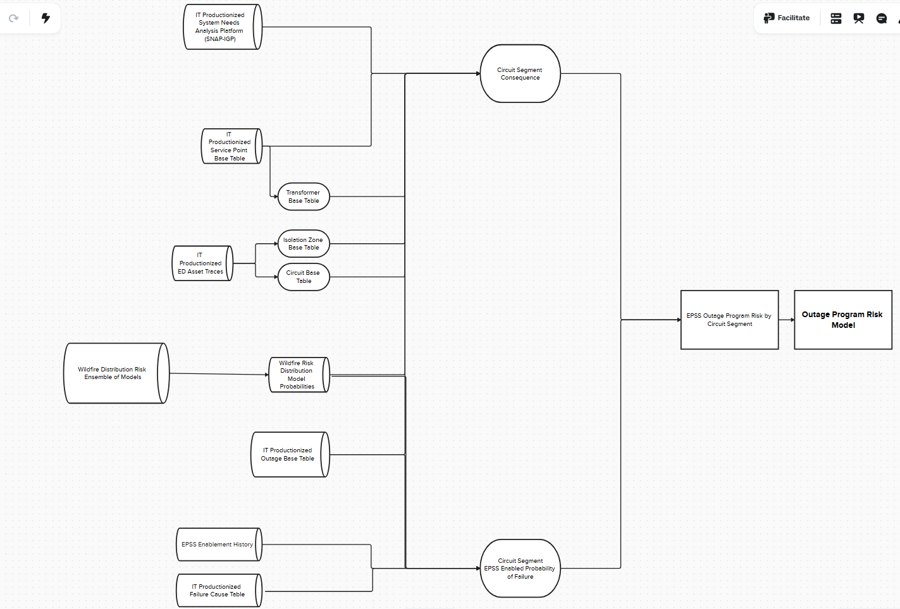
EPSS: Enterprise Data Infrastructure
Below is the design representation of the nearby enterprise data infrastructure developed to enable EPSS Outage Program Risk Model.

