Slide 1
Weather Station Maintenance & Calibration

Slide 2
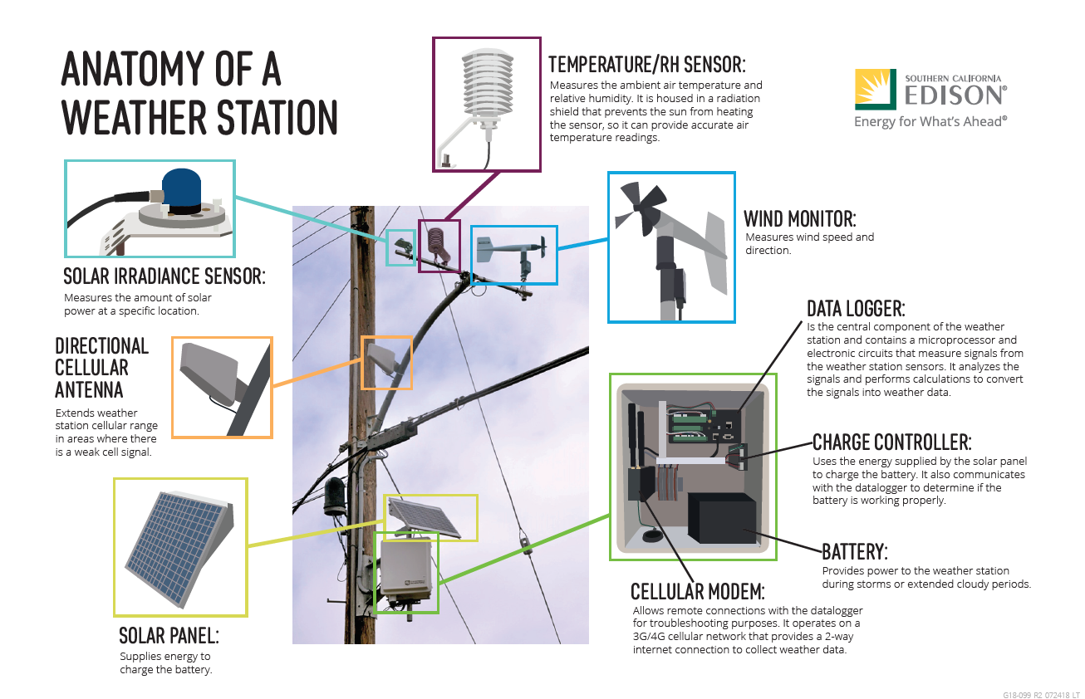

Slide 3
2023 Weather Stations Maintenance and Calibration
Maintenance Schedule:
Inspect and calibrate every location once a year, pending field conditions
  Record sensor performance
  Calibrate sensor to industry standard
  Inspect directional accuracy
  Batter performance
  Record all findings in calibration work sheet (Next page)
  Track all installs outside of standards and align with install standard
  Bring all stations to highest possible standard
Perform weather station trouble fixes:
  Poor performance
  Battery/solar recharge issues
  Vandalism
  Part replacement
  Add directional cell phone antennas to poor performing weather stations
  Weather station relocation

Slide 4
Weather Station Calibration Sample

Slide 5
SCE Weather Stations Calibration Check List (S.O.P.)
Upon Arrival at Weather Station
  Check orientation of wind sensor to true north w/ GPS (box on wind sensor should face due S)
  Attach keypad to station datalogger (CS I/O port)
  Sync the datalogger clock to local standard time
  Set Calibration Timer to 1 with keypad
  Turn on calibration case datalogger & sync clock to station datalogger
  Make note of Datalogger OS, time (GMT) battery voltages & errors on data sheet
Communications
  If Cellular:
    Check cell antenna tightness, wire connection, LED Status
    Update the cellular modem firmware and template to the latest version tested by WWG
    Existing Cellular Only – Move Modem White power wire from SW1 to 5V on Datalogger
  If Satellite:
    Connect to the satellite terminal interface, confirm 5 bars, Online status, GPS lock
    Attempt to Re-align the terminal for optimal placement: Point terminal to highest RSSI, reboot terminal, Re-point again for highest RSSI
    Confirm Port forwarding assignments for :6785 and :5682 ports
  Dual Communications:
    Existing Dual - Update the cellular modem firmware and template to the latest version tested by WWG
    Temporarily install a cellular modem and power it up
    View modem LED status, keep powered to relay Modem ID and LED Status to WWG
    If WWG confirms modem signal – permanently install cellular modem
  Verify comm status of cell modem & note signal strength on data sheet
Air Temperature and Relative Humidity Sensor
  Remove sensor from white louvered shield and place in fan aspirated shield
  Place calibrated temp/RH sensor from calibration case in fan aspirated shield
  Clean white louvered shield if dirty
  View readings on keypads attached to station and calibration case datalogger
  Note: it may take 10 to 15 minutes for the two sensors to stabilize
  Record readings from both sensors on calibration data sheet
  Replace station sensor back in louvered radiation shield.
  Move the Temp/RH Red power wire from 12v to SW2 on Datalogger
Solar Radiation (Pyranometer)
  Check pyranometer for cleanliness and wipe clean with damp cloth if dirty.
  Co-locate calibrated pyranometer next to station pyranometer, keep both level
  Compare readings between station and calibration sensor, note on data sheet
Wind Speed and Wind Direction Sensor
  Hold wind vane due south; view Dir reading on keypad record on data sheet
  Remove prop from wind sensor
  Check starting torque with propeller torque disc, enter value on data sheet
  Attach anemometer motor drive to wind sensor
  Check wind speed output at RPM test points and enter on data sheet
  Remove anemometer motor drive
  Remove wind sensor from pole mounting post, note alignment
  Place sensor on vane angle bench stand
  Test wind direction at 24 calibration points and note values on data sheet
  Replace sensor on pole mount and secure, note alignment to true north
  Hold wind vane due south; view Dir reading on keypad record on data sheet
  Replace prop, align notches on prop with nose cone and secure propeller nut
Completion
  Set calibration timer to zero
  Update the datalogger operating system to latest version
  Update the datalogger program to the latest version
  IF cell modem was installed: Update to Dual Comms program
  Re-enter the station PakBus and Circuit name in to datalogger
  Verify station’s lat/long and structure #; enter on calibration data sheet
  Take pictures of the station, ideally one from the North, South, East & West
Call Western Weather Group:
  Call Western weather group to report new station calibration
  Supply information on Station ID, Calibration date, calibration test results, Highest Satellite Terminal RSSI, Dual Comm cell modem information, wiring changes and cellular modem software updates
  Confirm current station readings with WWG over the phone
  Confirm this station is not on the Fixes List, or address the station Issue during calibration visit
  Inform WWG of any coordinate, circuit, structure changes that need to be made

