Slide 1


Center Update

Slide 2
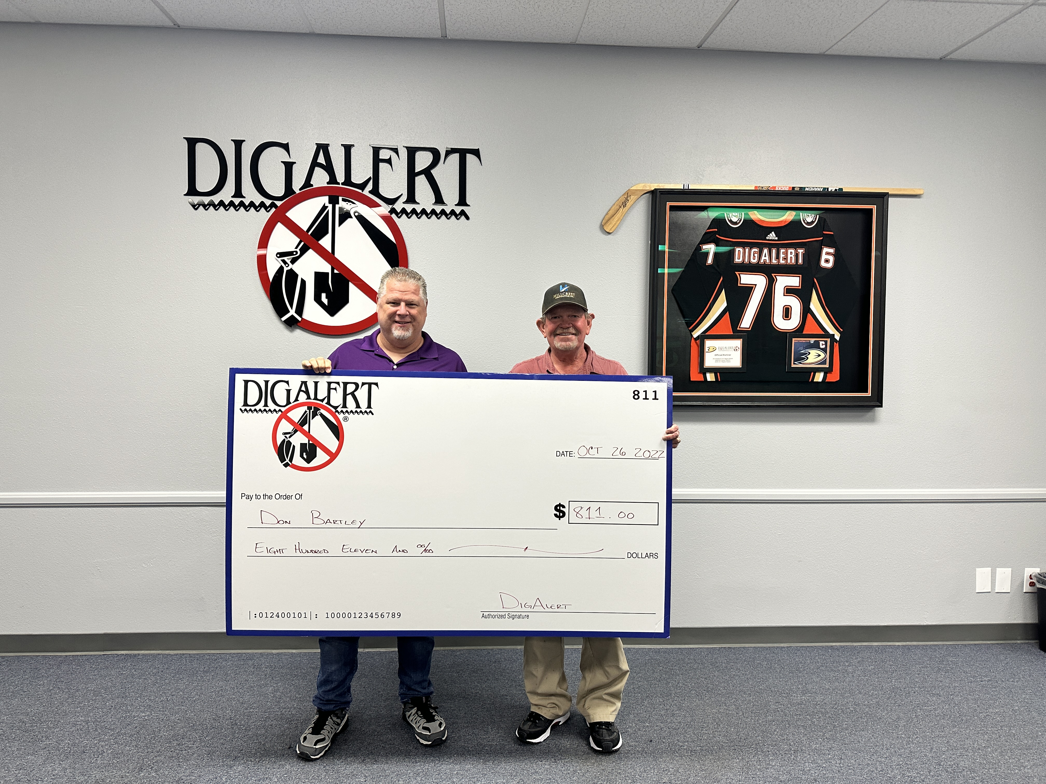
21st Millionth Ticket

Slide 3

Key Statistics Thru October 2022
Total tickets:
884,149
ACE tickets:
189
Amendment tickets:
32,677
Cancel tickets:
4,658
Damage/Exposed tickets:
4,900
New tickets:
456,165
No Response tickets:
11,224
Re-Mark tickets:
14,776
Renewal tickets:
359,258
Overall ticket volume% +/-:
11.79%
Web Ticket Percentage:
71.51%
Web Renewals:
97.4%
Total Transmissions:
7,497,655
Delivery Time:
3:54
Average hold time:
25 seconds
Average talk time:
6:27
Overall call volume:
-3.04%
Average CSR‘s:
20.3
CSR utilization:
68.12%

Slide 4
2022 EPR Statistics Thru October
Clear – No Conflict:
2,111,608
Clear – but privately owned on property:
28,133
Existing Markings Adequate:
161,764
No Markings Requested:
1,190,036
Locate Area Marked:
862,232
Area Marked Abandoned Line May be in Area:
2,046
Area Marked up to Private Owned Utility/Property:
29,113
Partially Marked – More Time Needed:
23,771
Provided facility location info to Excavator:
19,293
Bad Address Location Info - Resend ticket: 13,988
No Access to Locate Area – Resend ticket:
39,945
No Delineation – Resend Ticket:
92,577
Delineated Area Doesn’t Match Ticket – Resend Ticket:
15,638

Slide 5
More 2022 EPR Statistics Thru October
Contact Facility Owner for Further Info:
12,132
Requires Stand By – Contact Facility Owner:
11,077
Excavator Completed Work Prior to Due Date: 8,956
Negotiated Marking Schedule:
73,991
Visible Facility – Contact Owner if crossing:
364
Extraordinary Circumstances Exists – No Locate Due to Weather/Emergency/Safety Conditions:
6,686
Excavator No Show for Meet:
127
Mutually Agreed to Later Start Date/Time:
11,408
High Priority Line – On Site Meeting Required:
2,608
Field Meet Required – Contact Owner to Schedule:
4,229
Excavator Canceled Request:
74,669
Unable to Locate Using Standard Locating Techniques:
2,732
Member Didn’t Respond by required Time:
694,915
Traffic Control Required to Mark Lines:
381
Excavator not Digging within 14 days (Pre-Planning):
67
Scheduled Meet w/Excavator @ Requested Date:
986

Slide 6
2022 EPR No Response by Required Time
18,842 - under 1 hour
23,752 – between 1 and 4 hours late
16,211 – between 4 and 8 hours late
5,890 – between 8 and 12 hours late
50,447 - between 12 and 24 hours late
92,369 – more than 1 day late
469,447 – no response

Slide 7
EPR
Continued outreach to members not using EPR
  Email
  Mail (USPS)
  Phone

Slide 8
Ticket delivery options
Added HTML email
Added Web hooks
JSON
XML
Plain text
Change Excavator messages to HTML

Slide 9
System Updates
Reduced work area buffers on tickets from 150ft to 75ft minimum
Reduced member notifications area buffer from 150ft to 50ft minimum
Replaced firewalls to the latest technology
Upgraded core network backbone
Upgraded anti-ransomware and anti-attach hardware
Replaced entire backup technology at Corp and Datacenter locations

Slide 10
Underground Safety Board API’s
Developed an API for the Underground Safety Board to pull EPR data every night
June 2022 started sending a copy of all tickets in real time to the Underground Safety Board

Slide 11
Ticket changes in Jan 2023
Will have dedicated damage and exposed ticket types
Will add a return trip ticket type
Will add a question about if all work is taking place only in the pavement
Will add future ability to adopt
  Project tickets
  Project names
  Project IDs
  Searchable Tags (hashtags) to help future proof formats

Slide 12
Future changes
Norfield will be deploying the LOGiX platform
  New state of the art Mapping system (Nov 2022)
  New state of the art Center ticket system (2023)
  New state of the art Locator ticket management system (available now)
  New state of the art Web ticket system (2023)
  New state of the art AI Insights analytic system (2022/2023)
  New state of the art Excavator ticket management system (2022/2023)
New blade servers to replace current servers
WebTMS product is end of life and will end Q4 2023
Notes:
it)

Slide 13
Thank You

