Slide 1

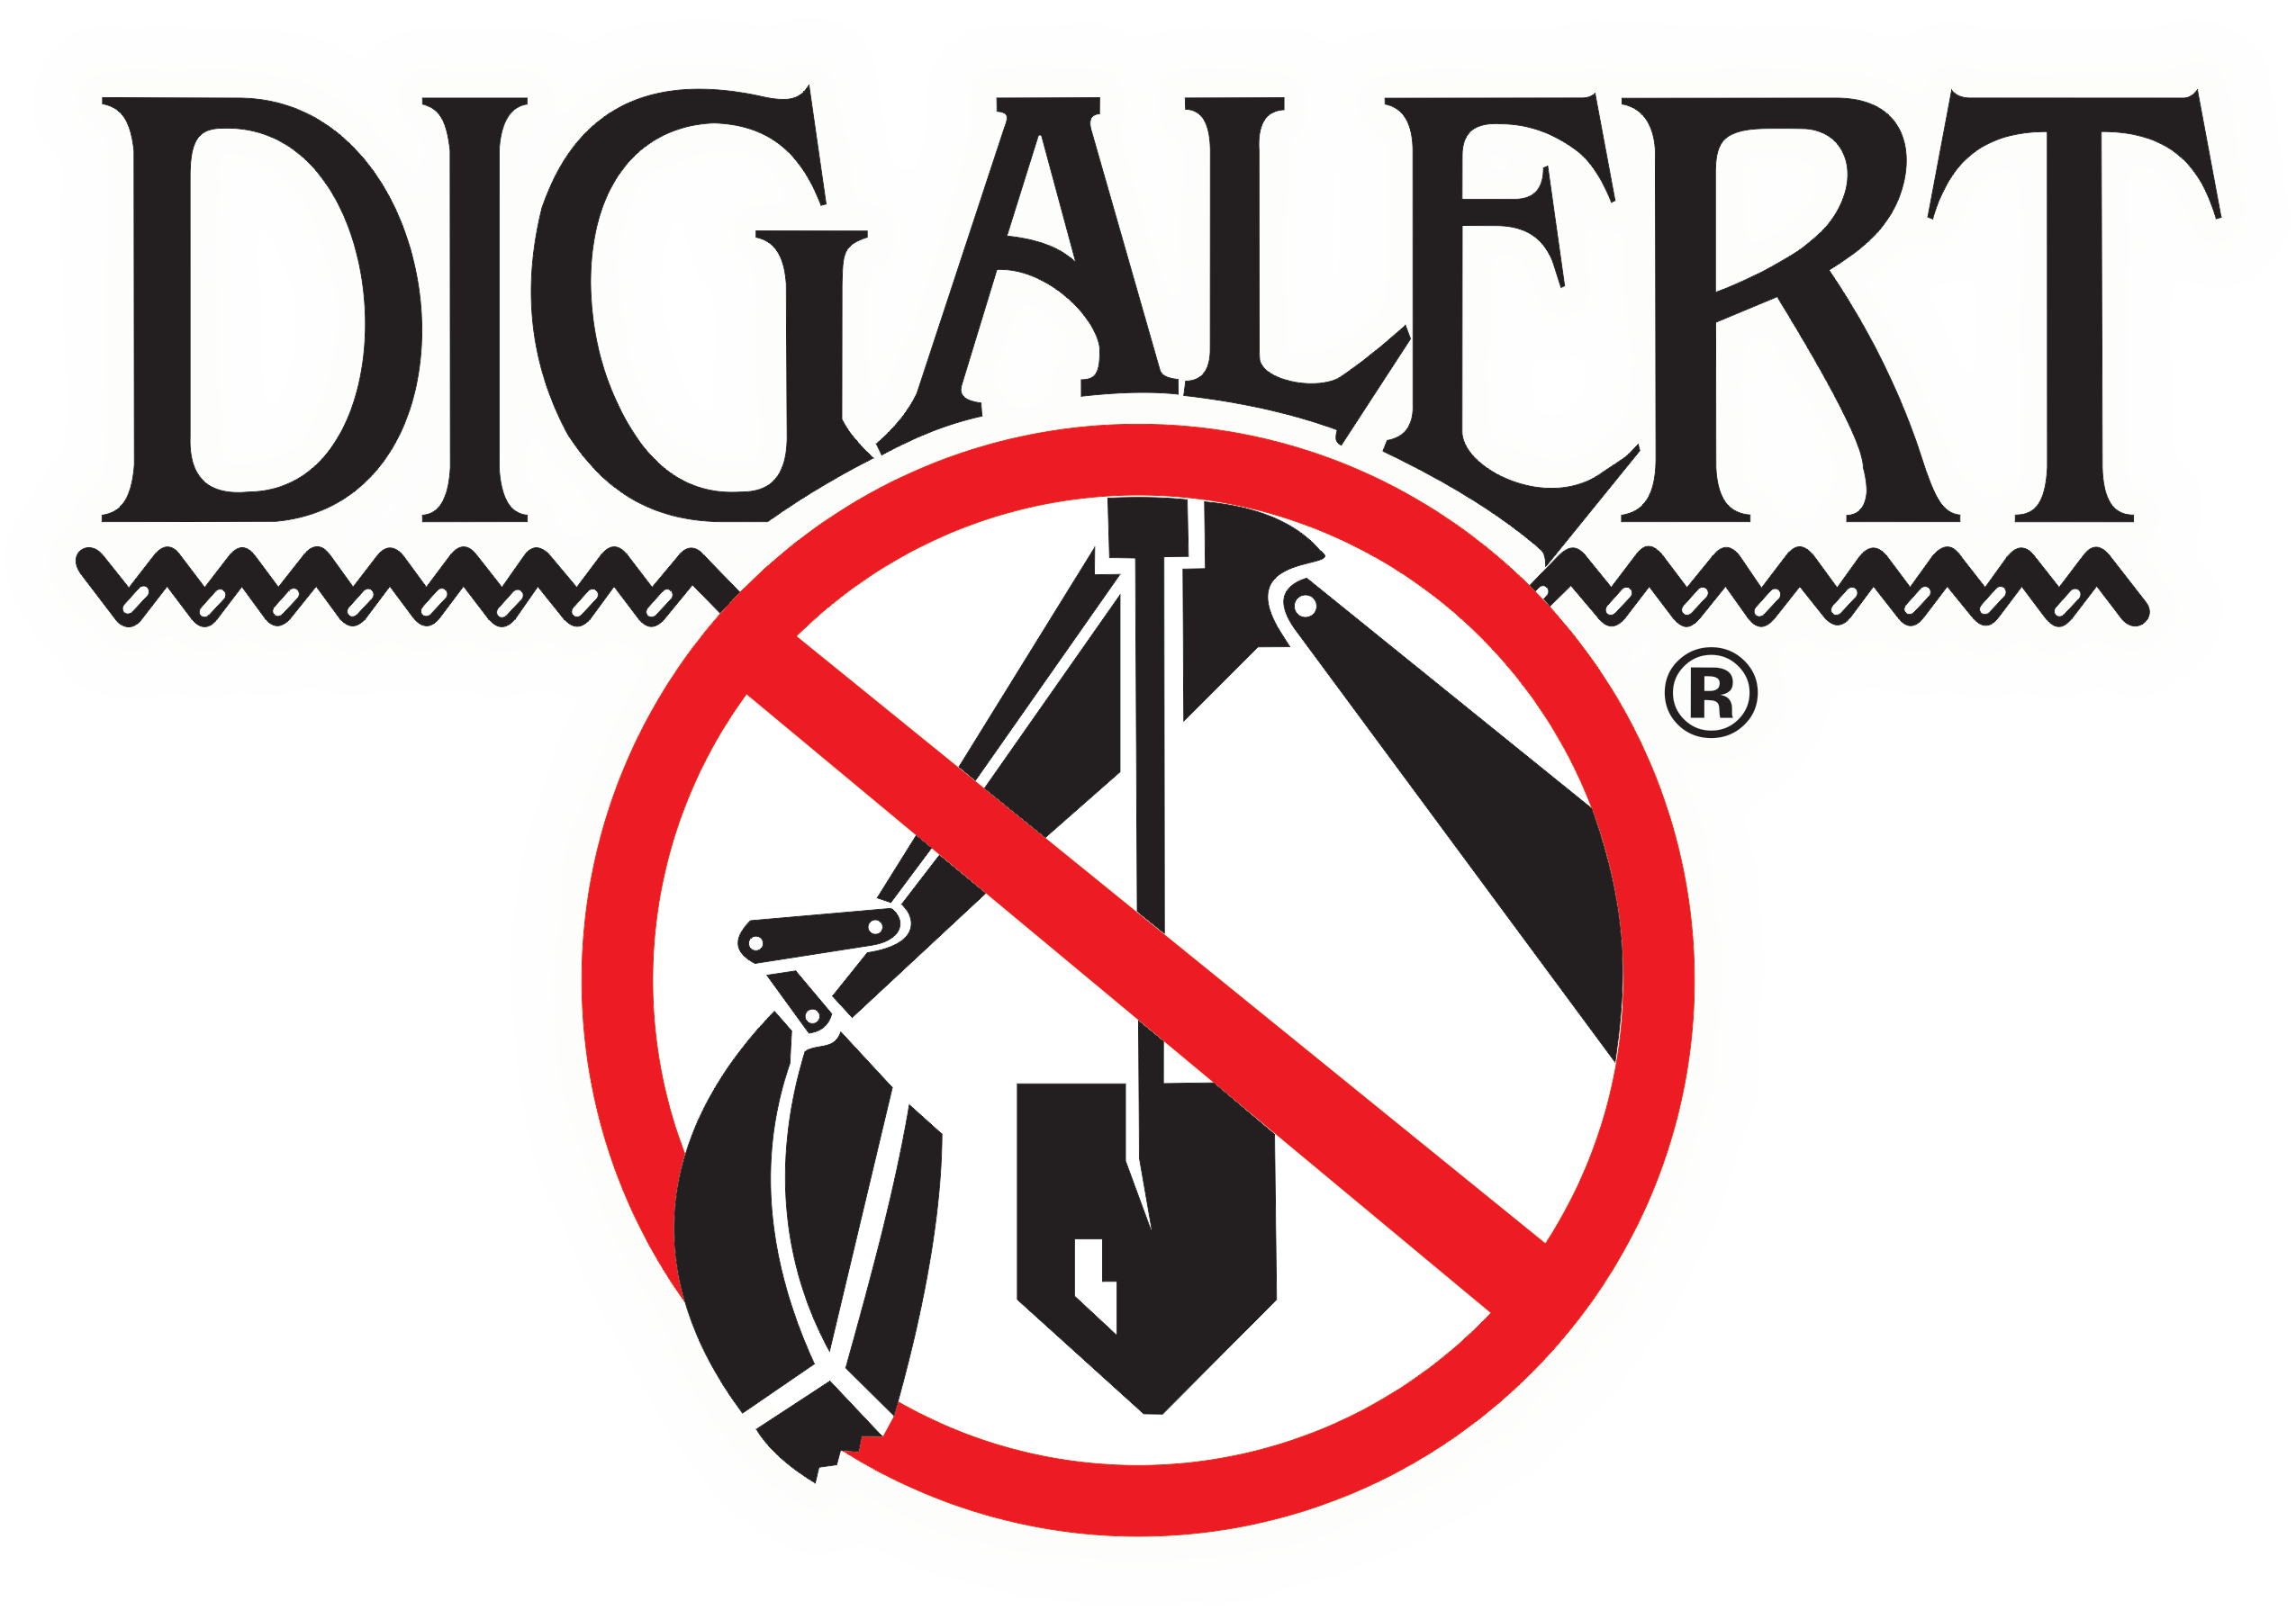
Center Update

Slide 2

2022 Key Statistics Thru Q2
Total tickets:
516,589
ACE tickets:
29
Amendment tickets:
19,484
Cancel tickets:
2,863
Damage/Exposed tickets:
2,829
New tickets:
271,147
No Response tickets:
6,295
Re-Mark tickets:
8,813
Renewal tickets:
204,893
Overall ticket volume:
10.54%
Web Ticket Percentage:
70.41%
Web Renewals: 97%
Total Transmissions: 4,423,762
Delivery Time:
2:25
Average hold time:
0:37
Average talk time:
6:46
Overall call volume:
-1.61%
Average CSR’s:
20.2
CSR utilization: 69.87%

Slide 3
2022 EPR Statistics Thru Q2
Clear – No Conflict:
1,275,350
Clear – but privately owned on property:
16,639
Existing Markings Adequate:
94,372
No Markings Requested:
672,049
Locate Area Marked:
514,459
Area Marked Abandoned Line May be in Area:
1,054
Area Marked up to Private Owned Utility:
14,205
Partially Marked – More Time Needed:
12,951
Provided facility location info to Excavator:
7,089
Bad Address Location Info - Resend ticket: 7,998
No Access to Locate Area – Resend ticket:
21,820
No Delineation – Resend Ticket:
51,155
Delineated Area Doesn’t Match Ticket – Resend Ticket:
7,730

Slide 4
More 2022 EPR Statistics Thru Q2
Contact Facility Owner for Further Info:
7,284
Requires Stand By – Contact Facility Owner:
6,586
Excavator Completed Work Prior to Due Date: 4,445
Negotiated Marking Schedule:
33,795
Visible Facility – Contact Owner if crossing:
188
Extraordinary Circumstances Exists – No Locate Due to Weather/Emergency/Safety Conditions:
5,472
Excavator No Show for Meet:
80
Mutually Agreed to Later Start Date/Time:
6,632
High Priority Line – On Site Meeting Required:
1,607
Excavator Canceled Request:
47,051
Unable to Locate Using Standard Locating Techniques:
1,843
Field Meet Required – Contact Owner to Schedule:
1,601
Member Didn’t Respond by required Time:
453,716
Traffic Control Required to Mark Lines:
279
Excavator not Digging within 14 days (Pre-Planning):
32
Scheduled Meet w/Excavator @ Requested Date:
387

Slide 5
2022 EPR No Response by Required Time
12,101 - under 1 hour
16,555 – between 1 and 4 hours late
12,358 – between 4 and 8 hours late
4,420 – between 8 and 12 hours late
37,592 - between 12 and 24 hours late
60,523 – more than 1 day late
302,272 – no response

Slide 6
Ticket Types - January 1, 2023
AMND – (Amendment tickets). For all reasons other than listed below that is not requesting any members to respond, for example: correcting a ticket, adding more information, clarifying the location, etc.
CNCL – (Cancel tickets). When the ticket is being canceled.
DMEX - (Damage/Exposed tickets). When the excavator states there is a damage or exposed line.
DMGE – (Damaged line ticket). When the excavator states there is a damaged line and requests members to respond.
DSGN – (Design tickets). FOR FUTURE USE ONLY. These tickets will not be used until a later date that has not been determined at this time.
EXPD - (Exposed tickets). When the excavator states there is an unmarked exposed line and requests the members to respond to be identified.
NEW – (New tickets). New first time tickets. The revision number will always be 00A or 00B.
NRSP – (No Response tickets). When the excavator states that any or all members failed to respond by the work date and time on the ticket.
RNEW – (Renewal tickets). Tickets where the work is continuing past 28 calendar days.
REMK – (Re-mark requested tickets). When the excavator requests any or all members to remark their lines. Also extends the ticket for 28 calendar days.
RTRN - (Return Trip requested). When the excavator states they need any or all members to respond to the site for any reason other than listed above. This ticket type will reset the legal notice for members required to respond back to the site.

Slide 7
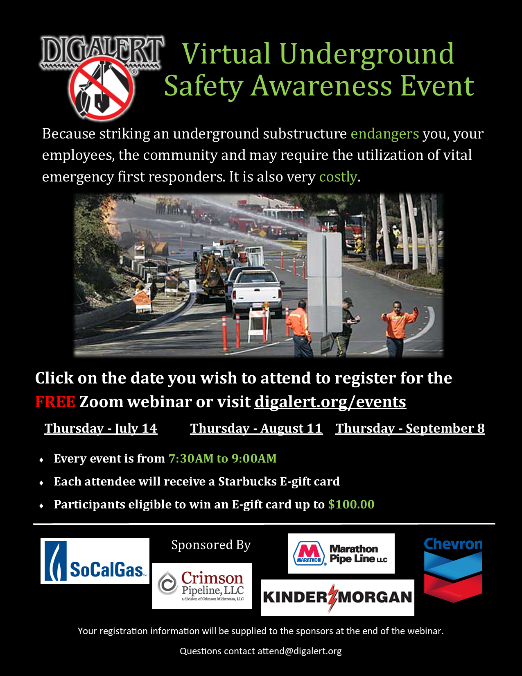
Monthly Underground Safety Awareness (USA) Webinars
Webinars are recorded and can be viewed on DigAlert’s You Tube channel

Slide 8
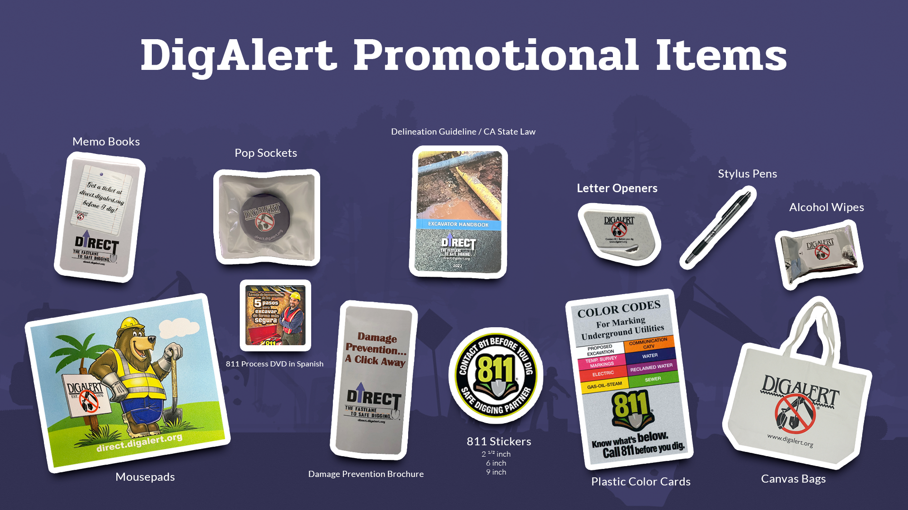
DigAlert Promotional Items

Slide 9
Questions

Slide 10
Thank You

