Slide 1
Underground Safety Board
Virtual Town Hall Meeting of the California Underground Safety Board
January 25, 2022
1-3 p.m.

Slide 2
Overview
Tuesday January 25, 2022
Move Update
2022 Save The Dates
Presentation and Question and Answer Session on Revised Fee Regulation

Slide 3
Move Update
Move Update

Slide 4
New Name
New Name!
Underground Safety
Board
Notes:
From 13 syllables to 6!

Slide 5
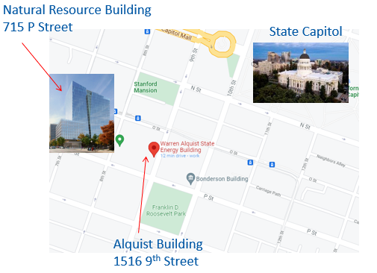
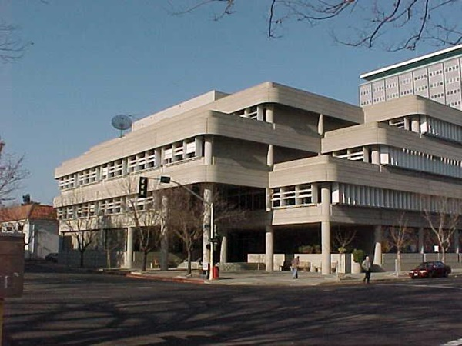
New Sacramento Office

Slide 6
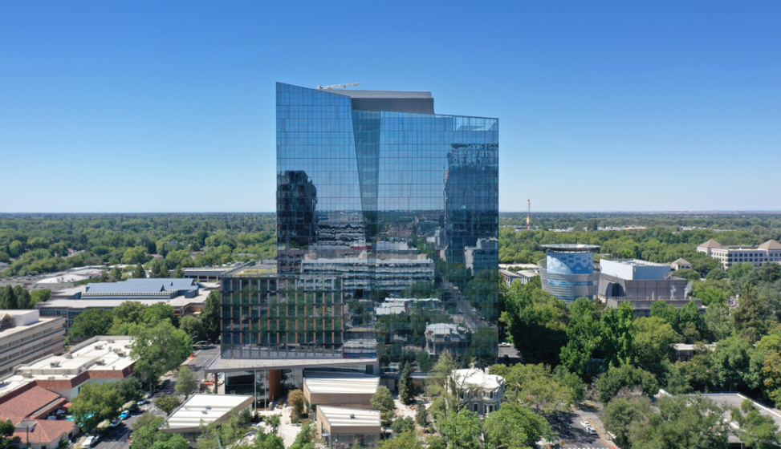
Underground Safety Board
Office of Energy Infrastructure Safety
715 P Street, 20th Floor
Sacramento CA 95814
Mailing Address

Slide 7
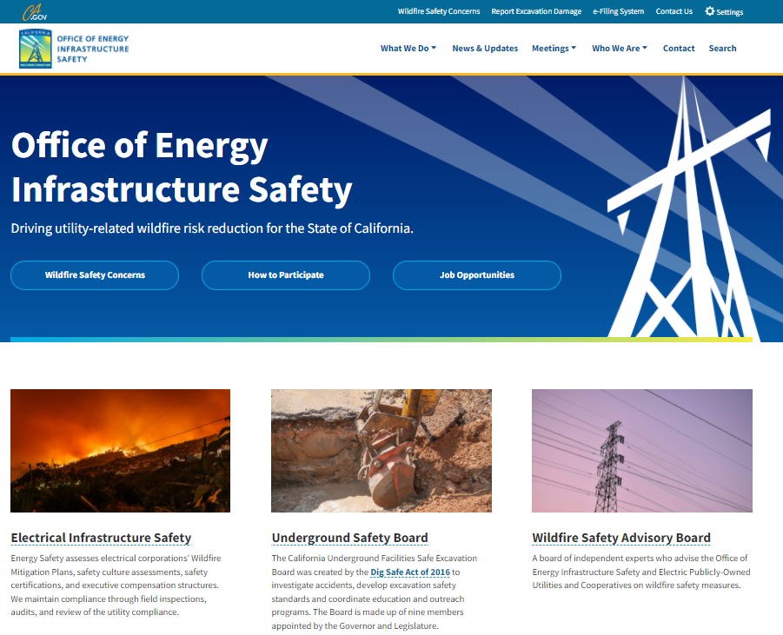
Website
https://energysafety.ca.gov/

Slide 8
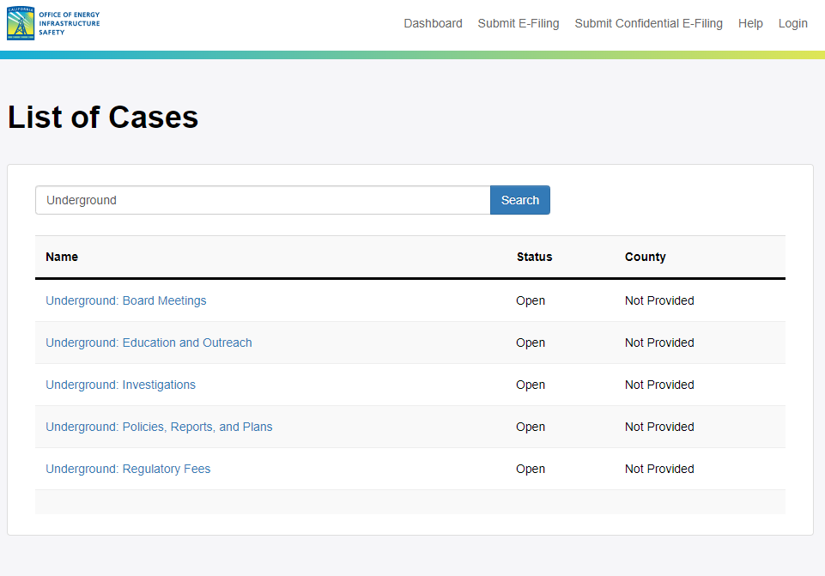
Stay
Informed
https://efiling.energysafety.ca.gov/

Slide 9
New Contact Emails
digboard@energysafety.ca.gov
fee.dig@energysafety.ca.gov

Slide 10
2022 Event Dates
2022 Event Dates

Slide 11
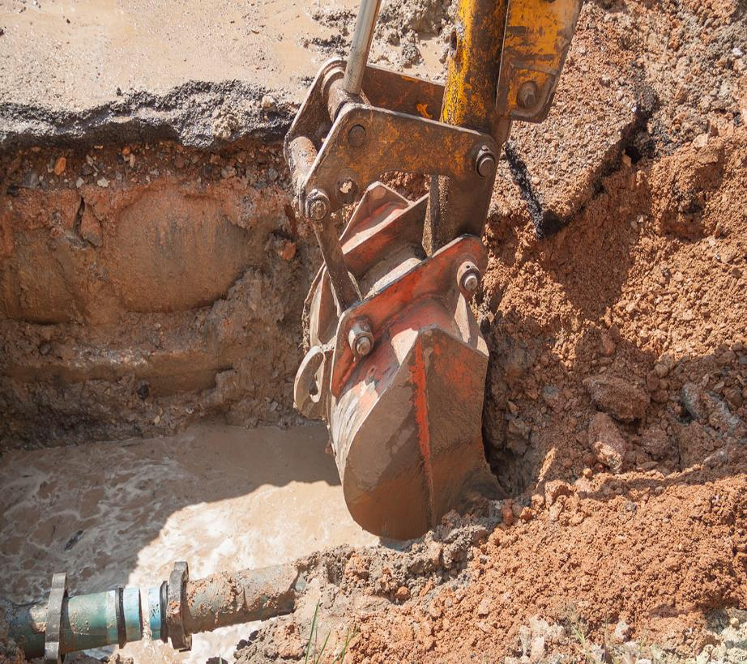
2022 Meeting and Workshop Dates
2022 Meeting and Workshop Dates
February 22: Workshop on Non-Violation Safety Issues in Investigations
February 28: Workshop on Planning and Design Ticket​
April 11-12: Board Meeting​
April 26: Workshop on Abandoned Lines​
July 11-12: Board Meeting​
September 12: Education and Outreach Meeting​
September 13: Enforcement Meeting​
November 7-8: Board Meeting

Slide 12
Fee Information
Fee Information

Slide 13

ORGANIZATIONS INVOLVED
California Government
Independent Nonprofit One-Call Centers
Underground Safety Board
Underground Service Alert of Northern California and Nevada dba USA North 811
Underground Service Alert of Southern California dba DigAlert

Slide 14
Stays the Same
  One-call centers issue invoices for Board fees as:
    Line-item on their existing member dues invoices
    OR
    Separate invoice dedicated to the Board fee

Slide 15
What is New?
  “New” tickets only
  Threshold increased to 500 tickets
  Total fee amount from $7mil to approx. $5mil

Slide 16
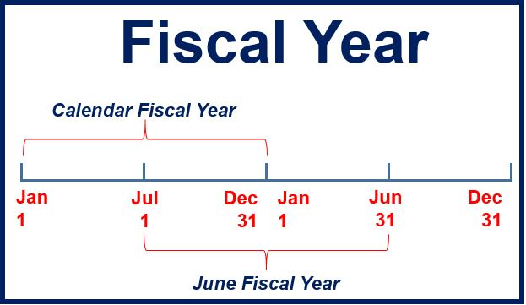
What is New?
  Fiscal year instead of Calendar year
  Amounts published months in advance
    By March 1

Slide 17
Billing Periods
  First full year Jul 2022 - Jun 2023
  “Bridge” Jan-Jun 2022 for alignment
Notes:
Based on new tickets from Jan-Jun 2021
Amount was decreased
*USA North 811 members on July billing may receive an invoice by 3/1/2022

Slide 18
Singular Payment Source
  Pay directly to the one-call center
  Use same W-9

Slide 19
Late Payments
  Reminders sent in advance
  90+ days = 5% Late Fee
  Pay directly to one-call center

Slide 20
One-call centers:
  Submit fees to Board quarterly
  Provide payment and info to Board monthly

Slide 21
Fee FAQs
Fee FAQs

Slide 22
What is the bill for?
  Operational costs of Board
  Authorized by CA Law (Gov’t Code § 4216.16(b))

Slide 23
Why am I not paying the state of CA directly?
  Prevent duplication of billing/collection
  One-call centers already billing members

Slide 24
Why are there two invoices?
  Regulation allows One-call centers two options:
    Line item
    OR
    Separate invoice

Slide 25
Why am I being billed twice for tickets?
  Fees are calculated from tickets, but go to different sources
      One-call centers for their costs of operations
      State of CA for costs of Underground Safety Board

Slide 26
Why is the ticket count different on invoices?
  Beginning with July 2022 invoices, will align with “new” tickets received in Jan-Dec of the previous calendar year
  But….
  May still differ due to billing methodologies used by One-call centers
    DigAlert = per ticket billed monthly
    USA North 811 = proportional share billed yearly
Notes:
Needed to fairly allocate fee

Slide 27
Questions
Questions?

Slide 28
Fee Contact Email
fee.dig@energysafety.ca.gov

Slide 29
Underground Safety Board websites
/
Office of Energy Infrastructure Safety
https://energysafety.ca.gov/
Underground Safety Board
https://energysafety.ca.gov/who-we-are/underground-safety-board/

