Slide 1
BEAR VALLEY ELECTRIC SERVICE
Presentation to OEIS Workshop on Executive Compensation
September 28, 2021
Keith Switzer, Vice President Regulatory Affairs Golden State Water

Slide 2
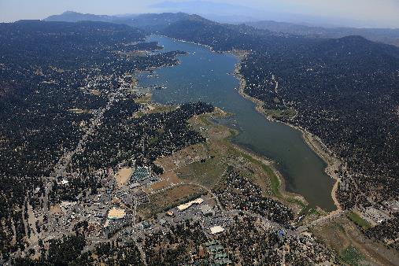

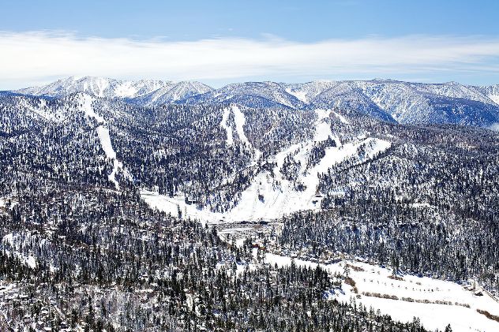
Overview of BVES
BVES is Small
  24,500 customers
  45 employees
  $40 million Annual Revenues
Service Territory
  32 Sq. Miles
  Rural, Mountainous
BVES is Small
  8% of AWR Revenues
BVES is New
  July 1, 2020

Slide 3
BVES Executive Compensation Overview
Compensation Structure has Multiple Components
Base Salary
Quarterly Term Incentive Plan (QTIP)
Short Term Incentive Plan (STIP)
Long Term Incentive Pay (LTIP)

Slide 4
Initial Challenges for BVES
2021 Executive Compensation Plan
No BVES officers prior to July 2020
Equity Considerations within AWR
  Overall TDC
  Composition of TDC
Base Salary Options
  Percent of TDC
  Increase TDC

Slide 5
BVES January 15, 2021 Submission
Three Component Structure:
  Base Salary 66.7% of TDC
  STIP 23.3% of TDC; 15 performance metrics
  LTIP 10% of TDC; 1 performance metric
April 14, 2021 Action Statement
  Denied BVES January 15 Submission
  BVES given 60 days to re-submit

Slide 6
BVES May 31 Submission
Four Component Structure:
  Base Salary: 49.4% of TDC
  QTIP: 5.3% of TDC
    2 Performance Metrics
    Quarterly performance period
  STIP: 34% of TDC
    13 Performance Metrics
    Yearly performance period
  LTIP: 11.3% of TDC
    1 Performance Metric
    Three-year performance period

Slide 7
2021 Performance Metrics
16 Metrics; 12 Safety-Related Metrics
QTIP: Fire Incidents; Employee Electric Contacts
STIP: Wildfire T&D Hardening Projects (Fuse Program, Current Limiting Fuse, Covered Wire, Evacuation Route, SAIDA, CAIDI, Safety Training, Recordable Work Incidents, Job Hazard Analysis, Vegetation Management); Supplier Diversity Utilization; SOX Deficiencies, EBITDA
LTIP: WMP Capital Spending

Slide 8
Timeline for 2022 Plan
October/November 2021: Assess Interim Performance on 2021 plan
November/December 2021: Review 2021 Metrics/Develop 2022 Metrics
January 2022: Finalize 2022 Metrics
Early February 2022: BVES Board approves 2022 Plan

