Slide 1

Pacific Gas and Electric Company
AB 1054 Executive Compensation Workshop
September 29, 2021

Slide 2
Agenda
Key Regulatory Requirements Overview
Executive Compensation Program Overview
Incentive Plan Lifecycle Timeline

Slide 3
Application of Key Regulatory Requirements
Requirement | Detail | How PG&E Currently Complies
Assembly Bill 1054 (AB 1054) | Applies to Executive Officers of the Utility | Applies to 6 officers of the Utility (Utility SEC Executive Officers + Corp. Sec and Treasurer)
 | Compensation plans must: Promote safety and financial stability; Include objective performance metrics that are measurable and enforceable | Bias towards outcome-based metrics Annual Incentive Plan (STIP): 75% Customer and Workforce Welfare and 25% Financial Stability Weightings Equity (LTIP): 35% Public Safety, 35% Customer Experience, and 30% Financial Stability Weightings for Performance Shares
 | Primary portion of compensation is based on achievement of objective performance measures | AB 1054 Officers only eligible for STIP and LTIP design is 100% Performance Shares (current interpretation) Performance Shares have a 3-year performance period
 | A significant portion of compensation must be based on long-term performance and value, and be held/deferred for at least 3 years
Plan of Reorganization Order Instituting Investigation (POR OII) Unique to PG&E | Base a significant portion of long-term incentive compensation on safety performance, as well as customer satisfaction, engagement, and welfare; the remaining portion may be based on financial performance or other considerations | LTIP: Performance Share Metrics 70% Operational: 35% Public Safety 35% Customer Experience 30% Financial

Slide 4
2020 Compensation Philosophy
Objective | How we achieve this
Pay for performance | A significant portion of total compensation is at-risk and based on performance – in 2020 an average of 61 percent of NEO¹ target compensation was at-risk. Short- and long-term incentives are earned based on performance reflecting safety, customer, operational, and financial goals, including shareholder return Metrics and goals are designed so as not to promote excessive risk-taking
Align with shareholders | Equity-based compensation, the value of which reflects movements in our stock price, accounted for an average of 47 percent of NEO¹ target compensation in 2020 Total shareholder return relative to our Performance Comparator Group is used as a performance measure
Provide market competitive pay | Target cash compensation should be competitive with the median for comparable roles in our Pay Comparator Group
Comply with legal requirements | The officer compensation structure is designed and reviewed to reflect both the letter and spirit of legal requirements
¹ Named Executive Officer (NEO) refers to officers required to be disclosed within the Joint Proxy. Because NEOs reflected in the most recent Joint Proxy include non-AB 1054 officers and do not include all AB 1054 officers, this is provided for illustrative purposes only.

Slide 5
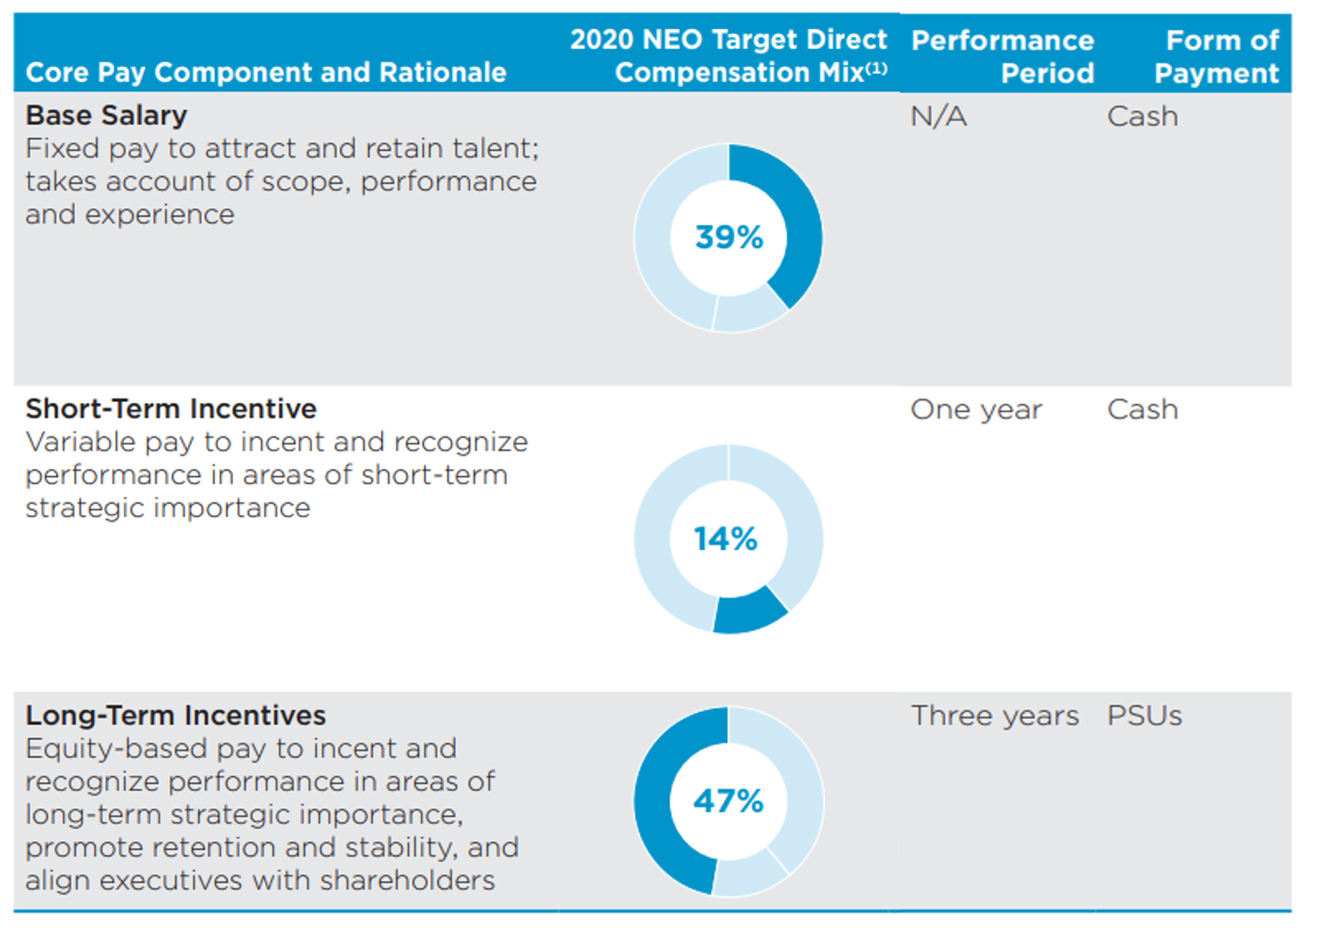
2020 Compensation Design Overview for NEOs
(1) Because NEOs reflected in the most recent Joint Proxy include non-AB 1054 officers and do not include all AB 1054 officers, this is provided for illustrative purposes only.

Slide 6
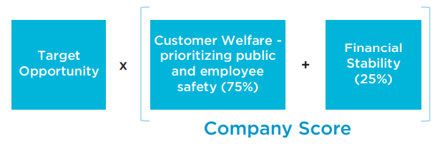
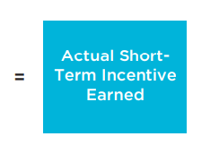
2021 AB 1054 Officer Short-Term Incentive Plan Design
Category | Metric
Customer and Workforce Welfare (prioritizing public and workforce safety) 75% | Electric Operations (20%) Wildfire Risk Reduction (15%) Wires Down Events Due to Equipment Failure (5%)
 | Gas Operations (10%) Large Overpressure Events Rate (5%) Gas Dig-Ins Reduction (5%)
 | Generation (10%) Safe Dam Operating Capacity (5%) DCPP Reliability and Safety Indicator (5%)
 | Workforce Safety (20%) Days Away, Restricted and Transferred Rate (5%) Serious Injuries Actuals (5%) Serious Injuries and Fatalities Investigation Timeliness (5%) Serious Injuries and Fatalities Corrective Action Timeliness (5%)
 | Operational Performance and Reliability (15%) Gas Customer Response (3.34%) 911 Emergency response (3.33%) Customers Experiencing Multiple Interruptions (3.33%) Average Speed of Answer for Emergencies (5%)
Financial Stability 25% | Non-GAAP Core Earnings Per Share (25%)
STIP Payment Formula*
(0 – 2.0)
Target is 1.0
* People and Compensation Committee exercises its discretion to accept, reject, or modify the final STIP score

Slide 7
2021 AB 1054 Officer LTIP Design
AB 1054 Officers currently receive 100% Performance Shares Performance Share Vesting Range: 0 – 2.0 (target is 1.0)
Non-AB 1054 officers receive a mixed LTIP design (70%-60% performance shares and 30%-40% restricted stock) which is more prevalent with broad market and peer practices
Category | Performance Share Metric
Public Safety 35% | System Hardening Effectiveness (Risk Miles) (17.5%) Enhanced Vegetation Management Effectiveness (Risk Miles) (17.5%)
Customer Experience 35% | Customer Satisfaction Score (17.5%) Public Safety Power Shutoff Notification Accuracy (17.5%)
Financial Stability 30% | Greater Affordability for Customers (15%) Relative Total Shareholder Return (15%)

Slide 8
Incentive Plan Development Timeline
Estimated Date | Step
October 2021 | Discuss high-level incentive 2022 compensation design structure with People and Compensation Committee
December 2021 | Finalize 2022 performance metrics and incentive structure with People and Compensation Committee (allows for communication and setting of supporting goals through the organization in Jan 2022)
January 2022 | Finalize 2022 STIP and LTIP design performance metric targets (e.g., Threshold, Target and Maximum Performance levels)
March 2022 | Grant equity awards under 2022 LTIP design (3-year performance period; fully vest March 2025)
April/May 2022 | 2022 Joint Proxy Statement and Shareholder meeting (includes annual shareholder Say on Pay Vote and any other Shareholder Proposals)
February 2023 | Committee certifies 2022 STIP Score(s)
February 2025 | Committee certifies 2022 LTIP performance shares score

