Slide 1
Executive Compensation Structure Workshop
Prepared for the Office of Energy Infrastructure Safety
September 29, 2021

Slide 2
NorthStar Background and Research Results

Slide 3
Overview
NorthStar Consulting Group
Research Approach
Data Collection
Results

Slide 4
NorthStar Consulting Group
Providing services to utilities and utility regulators since its founding in 1999.
  Electric, Gas, Water
  Investor-Owned Utilities (IOU) and Municipal Utilities
  Strong regulatory and operational focus
Extensive knowledge of California regulatory environment, recent proceedings and climate challenges.
  Review of Pacific Gas and Electric Company’s (PG&E) safety culture
  Review of PG&E’s Enhanced Vegetation Management (EVM) Enhanced Oversight Enforcement (EOE) Corrective Action Program
Reviews of executive compensation and performance measures:
National Fuel Gas Distribution Company | Consolidated Edison Company/Orange & Rockland
American Water | Entergy
Long Island Power Authority | Pacific Gas and Electric Company
National Grid | New Jersey Natural Gas
Nova Scotia Power | Customer Operations

Slide 5
Research Approach
Wildfire response and executive compensation considerations
  Australia
  Canada
Broad industry research
  Executive compensation trends
  Emphasis on safety
  Regulatory requirements
  Regulator involvement

Slide 6
Research Approach (Cont’d)
Company specific information
  US publicly traded companies
  UK/AU
  Other companies as time permitted
Compensation consultant interviews
NorthStar’s prior experience
Industry Sectors
Utilities
Aerospace and Defense, Airline/Aviation
Auto, Truck and Motor Parts
Biotechnology
Mining & Metals, Aluminum, Gold, Iron and Steel
Chemicals, Environmental Service & Equipment
Construction & Engineering
Consumer Goods, Household Products
Ground Freight and Logistics
Oil-Related Services & Equipment
Oil & Gas Drilling/Refining/Exploration & Production
Semiconductors

Slide 7
Company Data Collection
Current state of executive compensation
  Philosophy and compensation design
  Relative proportion of base salary, short-term and long-term incentives
  Other perquisites
  Use of performance modifiers
  Use of triggers or minimum performance requirements
  Performance Range - Threshold, minimum and maximum
  Level of metric detail reported

Slide 8
Company Data Collection (Cont’d)
Benchmark Comparison Data
  Target performance incentives as a proportion of base salary
  Short-term incentives
  Long-term incentives
  Metrics

Slide 9
NorthStar
Executive Compensation Considerations
Compensation philosophy – corporate entity versus group focus and associated tradeoffs
Tie to an organization’s overall strategy and goals – typically a challenge for some utilities
Authority of the Compensation Committee and willingness to exercise that authority
Incentive measures can be classified in a variety of ways depending on the perspective of the entity

Slide 10
NorthStar Executive Compensation Considerations (Cont’d)
An individual metric can serve as both a leading and lagging indicator
Metrics can be “gamed”
Metrics are frequently described at a high level and employees and executives may not truly understand the nuances of the metric
You cannot solve everything with metrics

Slide 11
Design Challenges
Target setting process
Complexity and line of sight throughout the organization
Consideration of the potential for unintended consequences (metric or calculation methodology)
Choice of peer groups – how payouts are determined
Sending the right signals and the right message
Mechanics of payouts

Slide 12
Australia
Combination of government-owned and publicly held utilities
Two significant bush fires
  2009 Black Saturday Bushfires
  2019/2020 East Victorian Bushfires (aka Black Summer)
To date, limited affect on executive officer compensation

Slide 13
Canada
Electricity market varies from province to province (and territory)
  Vertically integrated utility monopoly
  Competitive markets
Use of similar performance metrics, but compensation levels may be lower
No evidence of reform related to executive compensation

Slide 14
Canada (Cont’d)
In 2020, the Canadian Electricity Association (CEA) developed a best practice “Utility Wildfire Mitigation Guide” to prevent and mitigate the risk of:
  Utility assets igniting a wildfire
  Utility assets being impacted by a wildfire
Wildfires are only going to get worse
Many of the best practices are similar to those in California, including proactive de-energization

Slide 15
Research Results and Trends
Consideration of risks in other countries
Recent executive compensation trends
  Environmental, Social and Corporate Governance (ESG)
  COVID-19
  Diversity, Equity, and Inclusion (DEI)
Emphasis on safety
  More prevalent among utilities but still generally limited

Slide 16
California on the Forefront
California is on the forefront in terms of regulatory oversight of executive compensation to address wildfire concerns
Neither NorthStar, nor the compensation consultants interviewed could identify comparable examples

Slide 17
Philosophy and Design Comparison
Philosophy and Compensation Design
Other Perquisites
Use of Performance Modifiers
Triggers
Typical | CA Utilities
Pay for performance, target market median, clawback policy, stock ownership guidelines, no tax gross-ups | Similar
Typical | PG&E | Sempra | EIX
Generally limited | Some | Some | None
Typical | PG&E | Sempra | EIX
Generally limited | Eliminated its IPM, TSR modifier (+/- 25%) in 2021 | IPM (5%) | SCE has “foundational goals” which can reduce STIP and an IPM
Typical | CA Utilities
Infrequent | None

Slide 18
STI and LTI Design Comparison
Target STI as a percent of base salary
Target LTI as a percent of base salary
Performance Range
Typical STI | PG&E | Sempra | EIX
CEO average 138% | 2021: CEO 130% 2020: NEO 45%-75% | 2020: 50% - 145% | 2020: 70%-125%
Typical LTI | PG&E | Sempra | EIX
Similar range to California electric corporations, CEO percentages sometimes higher | 2021: CEO 685% 2020: NEO 87%-260% | 2020: 150% - 575% | 2020: 107%-538%
Typical Range | PG&E | Sempra | EIX
0% - 50% - 100% - 200% or 0% - 50% - 100% - 150% | Increased STIP cap to 200% in 2021 and reduced LTIP to 200% | STIP – 0% (threshold) - 200% | STIP 0% -200%, LTIP 0% - 25% - 100% - 200%

Slide 19
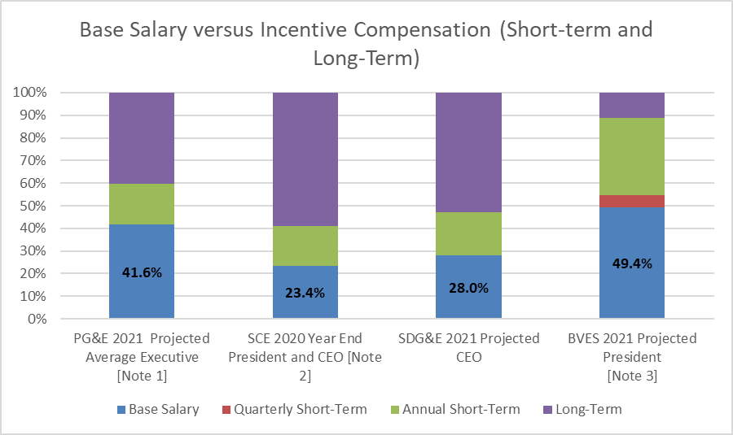
Relative Compensation Elements - Filings
California Electrical Corporations - 2021 Executive Compensation Submissions
Note 1: PG&E did not provide the percentage by position in its executive compensation submission, not even for the CEO, and numbers cannot be easily interpolated, so the reported average was used.
Note 2: SCE reported 2020 Year End actuals, others report 2021 projected.
Note 3: President is the only position included in the Executive Compensation Plan.
Source: 2021 Filings.

Slide 20
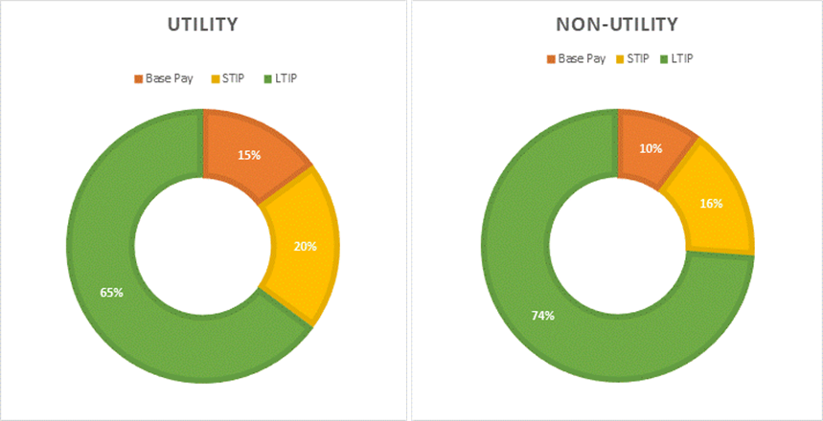
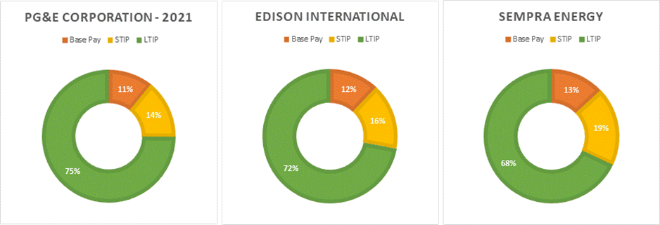
Relative Compensation Elements – Industry Benchmark
CEO Base Salary versus Incentive Compensation
California Electrical Corporations, Benchmark Utilities, and All Other Industries
Note 1: Twenty-five utilities. Does not include the California Electrical Corporations.
Note 2: Thirty-one non-utility companies.
Source: NorthStar benchmark analysis, 2021 Proxy Statements.
Note: 2021 Targets for PG&E, 2020 Targets for EIX and Sempra.
Source: 2021 Proxy Statements.

Slide 21
Short-Term Incentives
The California electric corporations’ STI programs include a significant number of metrics.
  2021 filings included the following individual STIP metrics, some of which may be indices of multiple measures
Number of Short-Term Incentive Plan Measures
Source: 2021 Utility Filings.
  It is interesting to note that the single commodity utilities (i.e., electric service only – BVES and SCE) have the smallest and the largest numbers of metrics, respectively
BVES | PG&E | SCE | SDG&E
11 | 15 | 24 | 17

Slide 22
Short-Term Incentives (Cont’d)
While high numbers of STI program metrics are more prevalent in the utility industry, it would not typically be considered a best practice.
  Lack of clarity regarding priorities
  Chasing small compensation components
  Poor line of sight for employees
  Some utilities address this by creating indices, which, unless it is a commonly-recognized industry index does not solve the problem

Slide 23
Compensation Consultant Takeaways
Utilities tend to have far more metrics than other industries
  Utilities - up to 30 or more STIP metrics
  Other industries - 3 to 5 metrics.
Utilities have a variety of stakeholders
There appears to be an inherent belief that if an item is not on the scorecard, it is not important
This leads to an increase in the number of measures

Slide 24
NorthStar Consulting Survey Takeaways
On average, the utilities included in NorthStar’s benchmark survey had 8 short-term incentive program metrics each
Other industries had 5 on average
Among the utilities surveyed, financial measures were still the most common
Followed by safety, reliability, and customer satisfaction/customer service

Slide 25
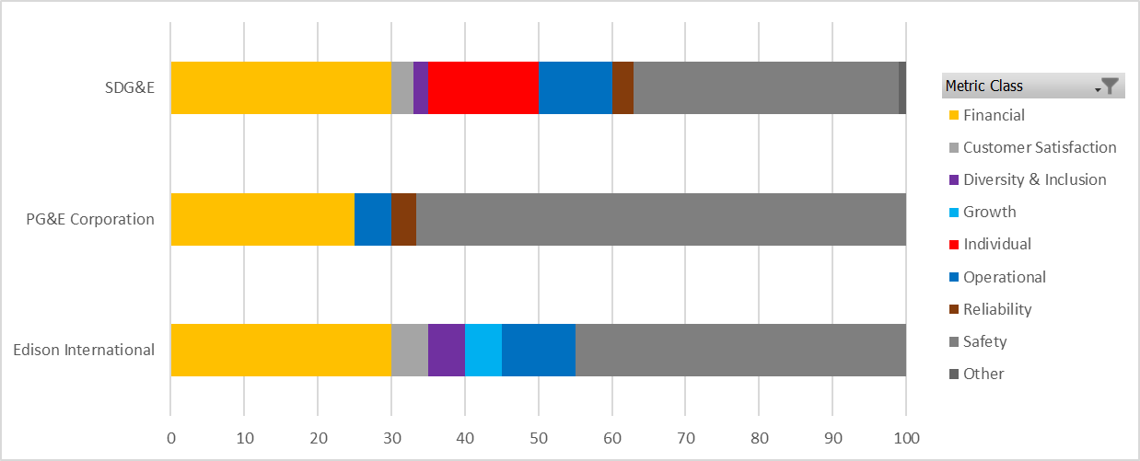
Short-Term Incentive –
CA Metric Comparison
STIP Weightings
Source: California IOU 2021 proxy statements, utility filings. NorthStar categorization.

Slide 26
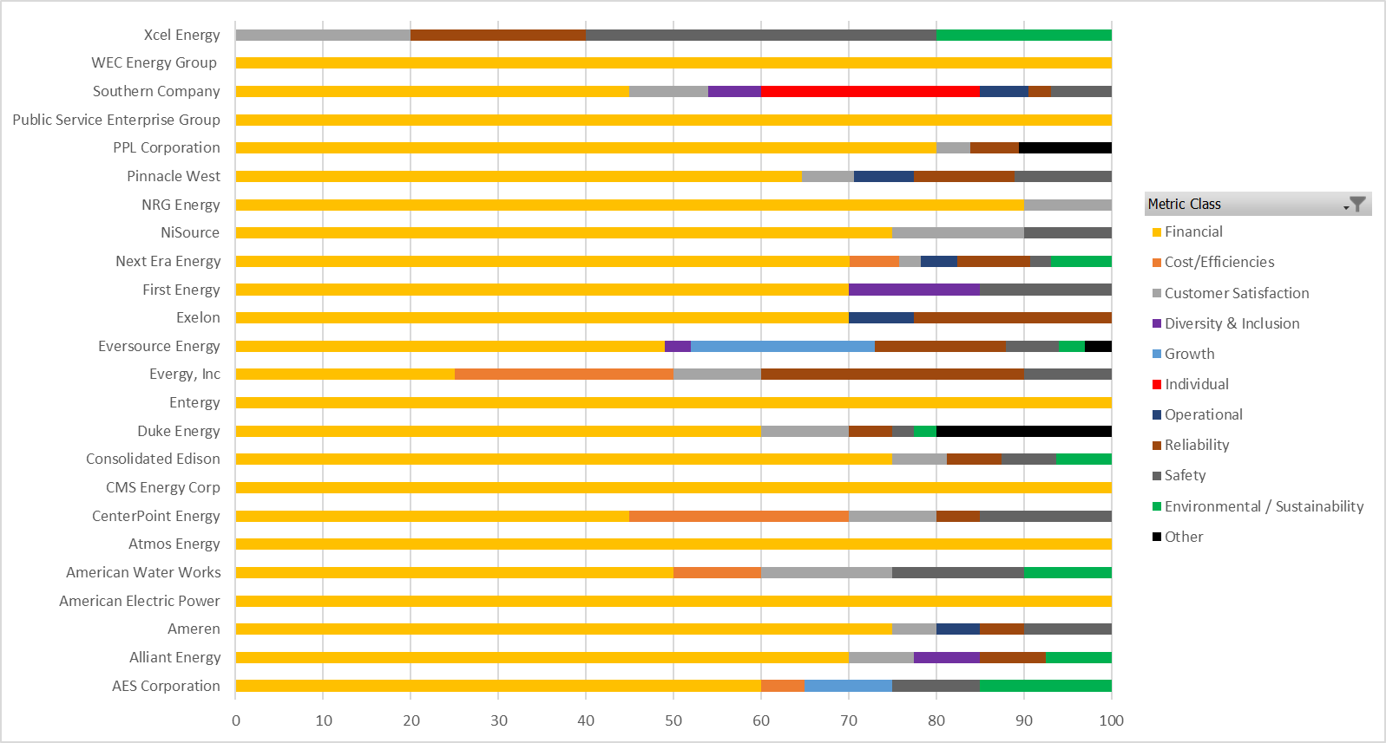
Short-Term Incentives – Other Utilities

Slide 27
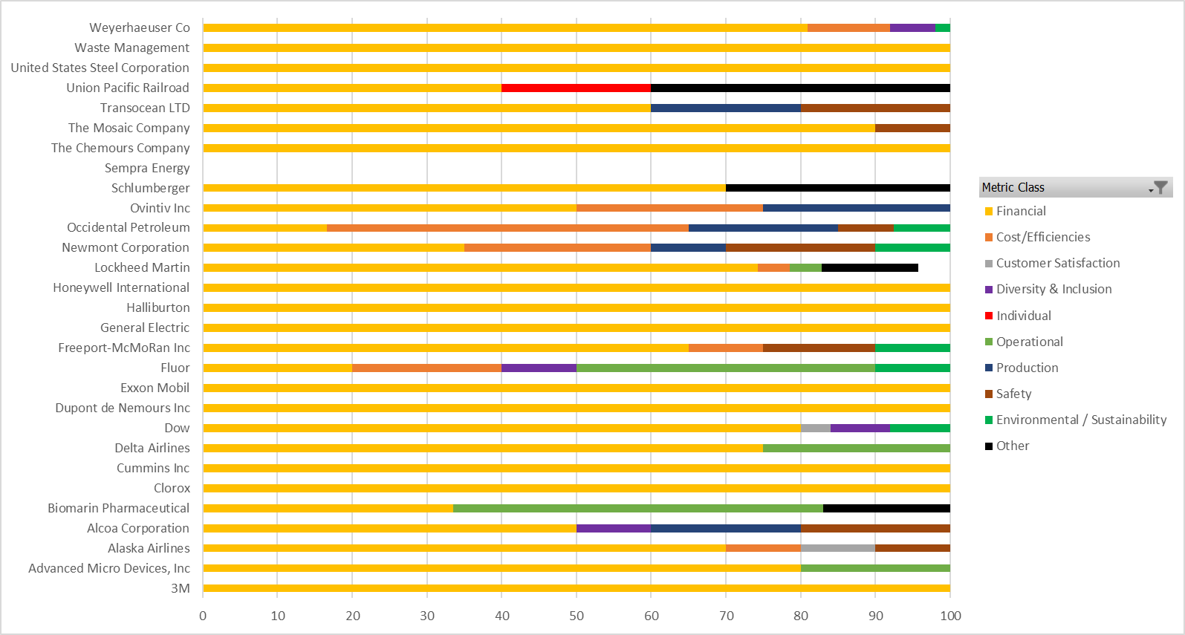
Short-Term Incentives – Non-Utilities

Slide 28
Long-Term Incentives - Benchmarking
LTIs that are operationally-based are less common than financial measures, but more prevalent within the utility industry.
  Historically, LTIPs have been based on a company’s financial performance.
  Of the 52 companies in NorthStar’s benchmark group (not including the California IOUs), eleven have non-financial measures as part of the LTIP (21 percent).
  Eight of the eleven are utilities.

Slide 29
  Companies with Non-Financial LTIP Measures – Non-Utility
Company | Non-Financial LTIP Measures | LTIP Weight | Year Added
Alcoa | Carbon Intensity: Consists of two goals: (i) reducing carbon emissions in the refining operations, such that the Company is the lowest carbon dioxide emitter in the industry (12.5%), and (ii) increasing production from direct and purchased renewable energy in the smelting operations (12.5%). | 25% | 2020
Biomarin Pharma-ceutical | Strategic Corporate Goals: Earned based on the number and nature of product development regulatory activities over the three-year performance period of 2020 through 2022. | 25% | 2019
Delta Airlines | Customer Service Performance: Based on net promoter score for four operating regions: Domestic, Latin America, Trans-Atlantic, Trans-Pacific | 25% | At least 5 years ago

Slide 30
Companies with Non-Financial LTIP Measures – Utility
Company | Non-Financial LTIP Measures | LTIP Weight | Year Added
Ameren | Clean Energy Transition: Measures the MW of renewable generation and energy storage additions over the three-year performance period. | 10% | 2019
American Electric Power AEP | Non-Emitting Generating Capacity Growth: Non-emitting generation capacity includes nuclear, hydro, wind, solar, energy efficiency, demand response and storage capacity owned or contracted by the Company as a percentage of AEP’s total owned and contracted generating capacity. Metric added in 2020. | 10% | 2020
Consolidated Edison [Note 1] | Employee and Public Safety: 5 measures. Environment and Sustainability: 5 measures. Operational Excellence: 5 measures. Customer Experience: 5 measures. | 25% | At least 5 years
Note 1: The measure counts are for the utility operations.
The Clean Energy Business and ConEd Transmission each have 10 measures across three of the four areas (excludes customer experience).

Slide 31
Companies with Non-Financial LTIP Measures – Utility (Cont’d)
Company | Non-Financial LTIP Measures | LTIP Weight | Year Added
Duke Energy | Safety: Total Incident Case Rate (TICR) as compared to companies in the Edison Electric Institute (EEI) Group 1 Large Company Index, excluding companies without gas or nuclear operations. | 17.5% | 2017
Next Era Energy | Operational Goals: 1) 3-year average employee safety - OSHA recordables/200,000 hours 2) Nuclear industry composite performance index (combined for Florida Power & Light (FPL) and NextEra Energy Resources nuclear facilities). 3) 3-year average equivalent forced outage rate (fossil and renewable generation). 4) FPL 3-year average service reliability—service unavailability (minutes). | 15% (3.75% each) | At least 5 years

Slide 32
Companies with Non-Financial LTIP Measures – Utility (Cont’d)
Company | Non-Financial LTIP Measures | LTIP Weight | Year Added
NiSource | Customer Value Framework: 1) Safety as measure by the National Safety Council Barometer Survey (NSCBS) Results 2) Customer Care – as measured by JD Power surveys. 3) Organizational Culture Improvement – as measured through a “Culture Index” 4) Environmental Impact – as measured by a Greenhouse Gas Emission reduction goal | 15% | 2018
Pinnacle West | Relative Operational Performance: Based on the following benchmarks: 1) Customer reliability 2) Customer-to-employee improvement ratio 3) Occupational Safety and Health Administration (OSHA) all incident injury rate 4) Nuclear capacity factor 5) Coal capacity factor | 35% | At least 5 years

Slide 33
Companies with Non-Financial LTIP Measures – Utility (Cont’d)
Company | Non-Financial LTIP Measures | LTIP Weight | Year Added
Southern Company | Environmental: Greenhouse gas reduction goal | 10% | 2019
Source: NorthStar Database – 2021 Proxy Statements.

Slide 34
Long-Term Incentive Measures – California
Only PG&E includes operational and safety metrics in its LTIP
California Electrical Corporation 2021 Filings
CA Electric Corp. | Measures
BVES | 100% financial [Note 1]
PG&E | 30% financial 35% customer 35% safety
SCE | 100% financial
SDG&E | 100% financial
Note 1: Based on achievement of Wildfire Mitigation Plan (WMP) Capital Expenditure (CapEx) targets.
Source: 2021 Filings and Proxy Statements, NorthStar Classification.

Slide 35
Long-Term Incentives Mechanisms – California
 | PG&E [Note 1] | SDG&E | SCE | BVES
Vehicle |  |  | Stock options (50%)
Vesting |  |  | 4-year graded
Vehicle |  | RSUs | RSUs (25%)
Vesting |  | 3-year ratably | 3-year cliff
Vehicle | PSUs 100% | PSU | PSUs (25%) | Performance Cash
Vesting | 3-year cliff | 3-year performance | 3-year cliff | 3-year cliff
Measures | EVM effectiveness (17.5%), System hardening effectiveness (17.5%) Customer Sat. (17.5%), PSPS Notification Accuracy (17.5%) Customer Affordability (15%), Relative TSR (15%) | Relative TSR - 2 S&P 500 Indices EPS | TSR, EPS | WMP Capital Expenditure
Note 1: PG&E’s plan includes RSUs for executives not subject to AB 1054.
Source: 2021 Filings and Proxy Statements.

Slide 36
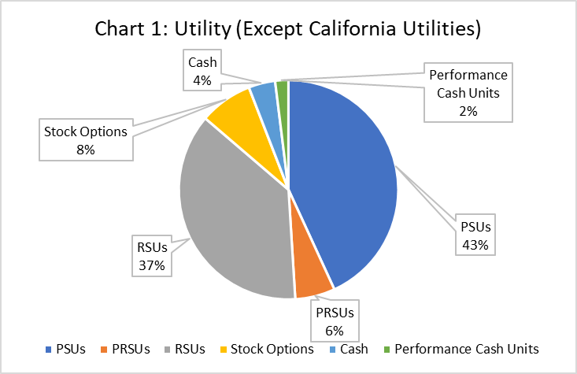
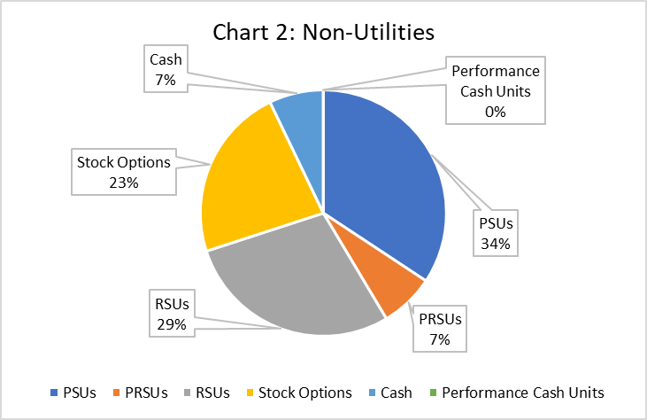
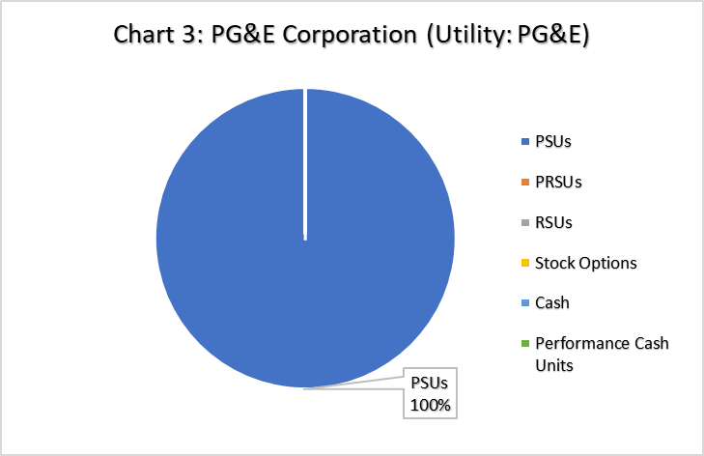
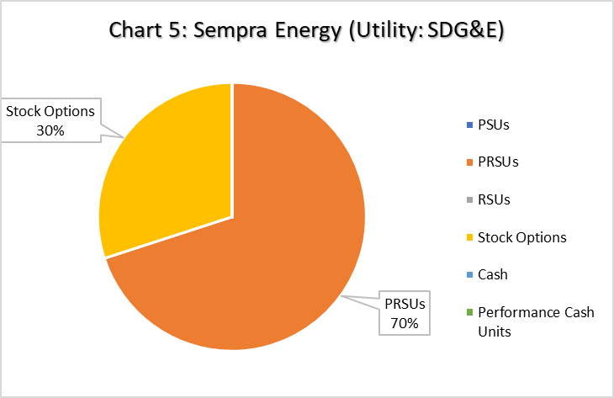
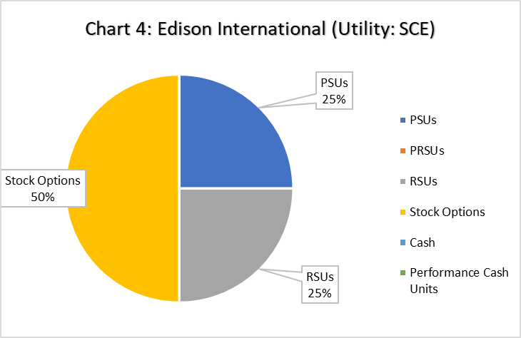
Long-Term Incentives - Comparison

