Slide 1
An Overview of Executive Compensation Practices in
Investor-Owned Utilities
John R. Ellerman
September 2021

Slide 2
In today’s workshop, I will focus on the following issues:
The main objectives of executive incentive compensation plans, with specific focus on safety performance
Summary of the key standard (minimum) executive incentive compensation practices in the energy industry, with a specific focus on safety performance
Summary of the key best practices for executive incentive compensation in the energy industry, with a specific focus on safety performance
Other regulatory influences that impact executive compensation design
An overview of European executive compensation practices compared with US practices, with a focus on safety performance, specifically in terms of the move to Environmental, Social and Governance (ESG) executive compensation structures in Europe
Evidence of changes in executive incentive compensation packages driving a change in performance. This includes examples of measures that were particularly successful in enhancing safety
An explanation of the role of the board compensation committee in determining executive compensation structures

Slide 3
Executive Compensation is awarded in 5 components
“Total Executive Compensation”
Perquisites
Employee Benefits
Long-term Incentive
Annual Incentive
Base Salary
“Total Direct Compensation”
Long-term Incentive
Annual Incentive
Base Salary
Because employee benefits and perquisites are the smallest elements of executive pay, we will focus on total direct compensation and the direct compensation components
Employee benefits and perquisites are considered to be not performance-based and may vary significantly from company to company

Slide 4
Attributes of Total Direct Compensation
Base Salary
  Fixed compensation cost
  Typically, the baseline or foundation for other forms of compensation
  Represents 10% to 20% of a CEO’s total direct compensation opportunity
  Represents 20% to 30% of the total direct compensation opportunity for other Named Executive Officers (NEOs)
  Salaries are reviewed annually and may be adjusted at that time to reflect executive performance, market competitiveness, change in executive responsibilities, etc.
Annual Incentive
  Variable compensation cost
  Typically expensed as percentage of base salary at target or expected performance level
  Performance measurement period is one year or less and typically tied to company fiscal year
  Size of annual award and percent of target earned tied to specific performance metrics: company, division, business unit, and/or individual
  More and more companies (utilities as well as other industry sectors) have pushed annual incentive compensation deeper into their organizations
  Annual incentives are typically paid in cash within 75 days following completion of fiscal year
  Some companies have implemented deferred compensation plans for executives to defer receipt of annual incentives

Slide 5
Attributes of Total Direct Compensation (cont’d)
Long-Term Incentive
  Variable compensation cost
  Long-term incentives (LTI) are typically granted on an annual basis
  Performance measurement period is greater than one year (typically 3 to 5 years performance measurement period, sometimes as long as 10 years for some vehicles like stock options)
  Most LTI plans are directly tied to company stock price
  LTI performance plans (e.g., performance shares, performance units, etc.), have replaced stock options as the most prevalent LTI vehicle in both the utility and general industry sectors
  LTI compensation represents the largest component of executive pay (CEO annual grant value equal to 5 to 10 times annual base salary)
  LTI compensation is subject to complex valuation and accounting measurements
    ASC 718
    Fair value at date of grant
    Realized or realizable compensation measurements
  Most LTI awards are paid in the form of company stock
  LTI compensation, unlike annual incentive, is more restrictive in its participation than annual incentives

Slide 6
Annual Incentive Plan Design and Practices
Objectives
  To communicate key financial, operational, and strategic goals
  To offer a variable form of compensation tied directly to performance
  To reward high performance
  To retain and motivate the best executives and workers
  To offer a competitive level of compensation tied to marketplace benchmarks
Annual Award Opportunity
Hypothetical Example
Annual Base Salary | X | Target AI Opportunity | X | Performance Achieved | X | Modifier (Optional) | = | Final Award Earned
$1,000,000 | X | 150% | X | 112% | X | -10% | = | $1,512,000

Slide 7
Annual Incentive Plan Design and Practices (cont’d)
Performance Measurement
  Most annual incentive plans are 100% formulaic in their application
  Performance goals and metrics are typically developed by top management and reviewed/approved by the Board’s compensation committee
  Performance goals may include the following metrics (absolute vs. relative)
    Financial (EPS, ROCE, Cash Flow, EBITDA, etc.)
    Operational (O&M expense, reliability, etc.)
    Safety & Environmental (TICR Employees, Reportable Environmental Events, etc.)
    Customer Satisfaction (Customer survey results)
    Individual Objectives
Weighting of Performance Metrics
  Performance metrics are typically weighted to reflect importance of the metrics to business success and annual operating plans
  Each metric will typically have:
Below Threshold | ― | 0% Achievement (Payout)
Threshold | ― | 50% Achievement (Payout)
Target | ― | 100% Achievement (Payout)
Maximum | ― | 200% Achievement (Payout)

Slide 8
Annual Incentive Plan Design and Practices (cont’d)
Goal-Setting Process
  Top management develops initial goals and targets as part of the annual planning and budgeting process
  For example, annual financial goals and targets are initially reviewed and approved by the Board Finance Committee. In turn, the Finance Committee recommends financial targets to the Compensation Committee for further review and approval. The Compensation Committee presents the annual incentive plan goals and targets to the Board of Directors
  The Compensation Committee plays a key role in the goal-setting process by rigorously reviewing and approving performance goals/targets at the beginning of the plan year as well as evaluation of actual performance versus goals/targets at the end of the plan year
Performance Modifier
  Some companies have “performance modifiers” which can be used to adjust awards. Modifiers may be positive or negative, or negative only. Modifiers may be quantitative or qualitative in their application
  For example, Duke Energy has a “Safety Modifier” with respect to its annual incentive plan. If the company experiences a significant positive operational event during the plan year, award payments will be increased by 5%. If there is a significant negative operational event, incentive payments may be decreased by 5%. In 2020, Duke Energy reduced annual incentive payouts to its NEOs by 5% due to a work-related fatality

Slide 9
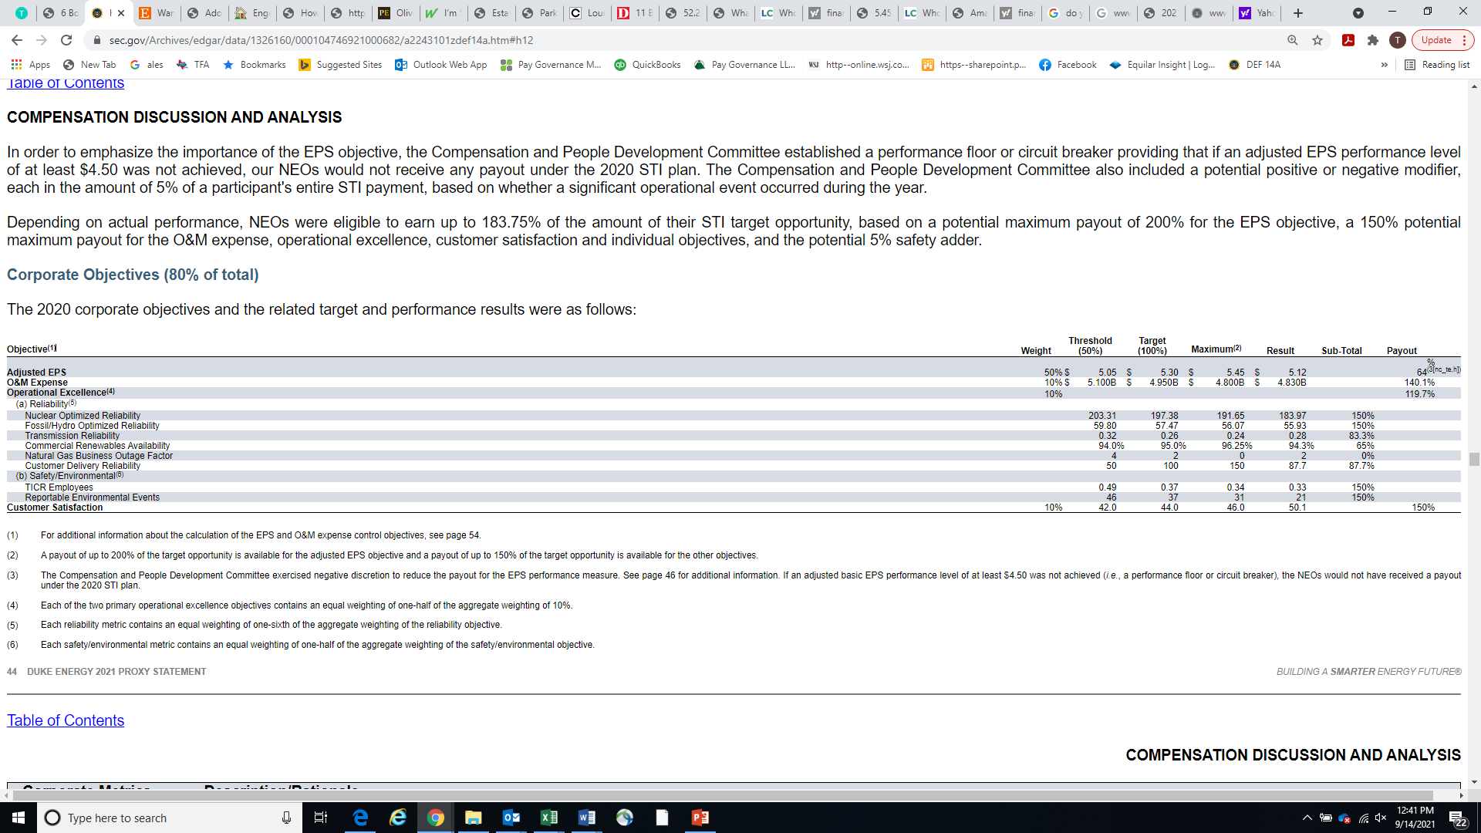
Annual Incentive Plan Design and Practices (cont’d)
Example of Annual Incentive Plan Scorecard
Source: Duke Energy 2021 Proxy Statement
(1) For additional information about the calculation of the EPS and O&M expense control objectives, see page 54.
(2) A payout of up to 200% of the target opportunity is available for the adjusted EPS objective and a payout of up to 150% of the target opportunity is available
for the other objectives.
(3) The Compensation and People Development Committee exercised negative discretion to reduce the payout for the EPS performance measure. See page 46
for additional information. If an adjusted basic EPS performance level of at least $4.50 was not achieved (i.e., a performance floor or circuit breaker), the NEOs would
not have received a payout under the 2020 STI plan.
(4) Each of the two primary operational excellence objectives contains an equal weighting of one-half of the aggregate weighting of 10%.
(5) Each reliability metric contains an equal weighting of one-sixth of the aggregate weighting of the reliability objective.
(6) Each safety/environmental metric contains an equal weighting of one-half of the aggregate weighting of the safety/environmental objective.

Slide 10
Long-Term Incentive (LTI) Plan Design and Practices
Objectives
  To counter-balance short-term focus of annual incentives
  To align management interests with the interests of shareholders
  To motivate creation of long-term value of the company
  To serve as a long-term retention vehicle
  To reinforce a pay-for-performance culture
Types of LTI Vehicles
  Stock Options
  Performance Shares, Performance-Based RSUs, Performance Units
  Time-Lapse Restricted Stock
  Hybrid Designs
  Note – many companies implement and use 2 or more LTI vehicles
Frequency of Grant
  Annually

Slide 11
Long-Term Incentive (LTI) Plan Design and Practices (cont’d)
Participation
  Typically limited to top management and key decision-makers
  Some organizations have pushed LTI grants into middle management and professional ranks
Size of Grant Opportunities
  Like annual incentives, LTI grants are usually expressed as a percentage of participant’s base salary
  In a large utility company, LTI annual grant may be 750% of CEO’s base salary or higher
  Competitive grants for other NEOs are typically in the range of 200% to 500% of base salary
Performance Measurement
  Performance Shares and other LTI Performance Plans have typical 3-year measurement periods with the following metrics:
    Relative TSR (Total Shareholder Return)
    Financial Goals (EPS, ROE, Other measured on an absolute or relative basis)
  Time-Lapse Restricted Stock, which is granted without ties to a performance metric, may represent 30% of total award opportunity
  Operational goals, such as safety or environmental compliance, are rarely included in LTI incentives (although there are exceptions)

Slide 12
Long-Term Incentive (LTI) Plan Design and Practices (cont’d)
Goal-Setting Process
  The establishment of long-term performance goals and targets is similar to the process used in setting annual incentive goals
  Some LTI Performance Plans use a singular 3-year performance target like relative TSR, although some plans will include 2 to 3 metrics which will be weighted

Slide 13
Long-Term Incentive (LTI) Plan Design and Practices (cont’d)
Example of LTI Program
Source: The Southern Company 2021 Annual Proxy

Slide 14
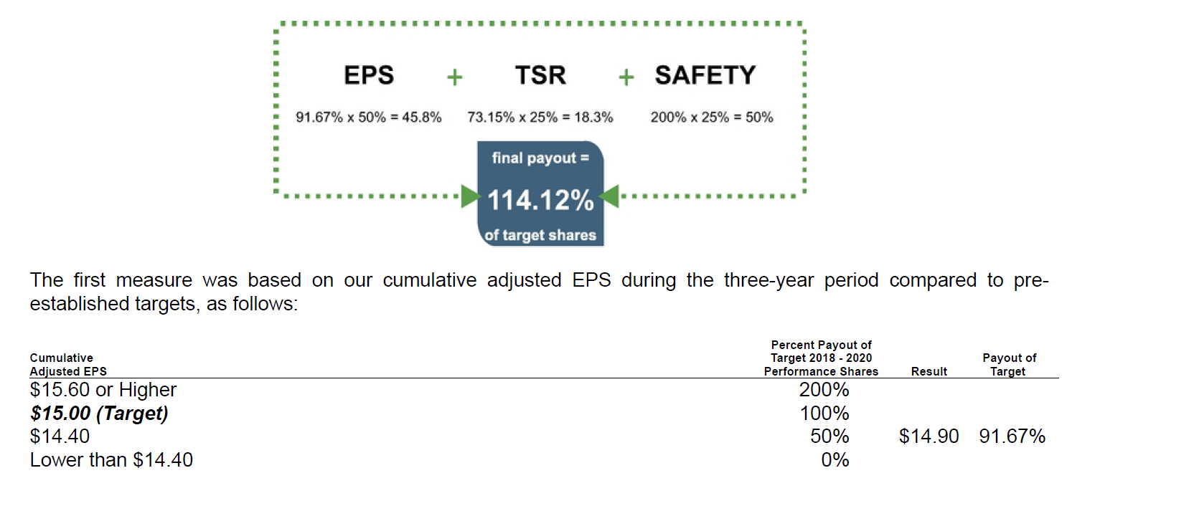
Long-Term Incentive (LTI) Plan Design and Practices (cont’d)
Example of LTI Program
Source: Duke Energy 2021 Annual Proxy
Duke Energy Performance Shares have 3 performance metrics
  EPS 3-year metric – weighted 50%
  Relative TSR Versus Peers 3-year metric –weighted 25%
  Safety 3-year metric – weighted 25%

Slide 15
Long-Term Incentive (LTI) Plan Design and Practices (cont’d)
Duke’s LTI program is one of the few utility companies that measures safety in its long-term incentives
Duke’s safety metric is measured on its TICR for employees as compared to companies in the EEI Group 1 Large Company Index (excluding companies without gas or nuclear operations) according to the following payout schedule:
*TICR is a measure of the number of occupational injuries and illnesses per 100 employees
Relative TICR Performance Schedule
Weighting – 25%

Slide 16
Long-Term Incentive (LTI) Plan Design and Practices (cont’d)
Share Retention
  Most LTI programs are subject to elaborate share vesting, ownership, and/or retention guidelines
  A large company utility CEO will typically have a share ownership guideline of 6x base salary
  Institutional investors carefully monitor top management share ownership
  Performance shares and related performance-based company stock must be earned before it counts towards share ownership guidelines
Other Considerations
  The number of shares granted each year, the number of shares held in LTI plan reserves, and new requests for authority to grant additional shares (subject to shareholder approval) are carefully watched with respect to prospective dilution (share utilization, stock overhang)

Slide 17
Inclusion of Safety in Incentive Plan Performance Metrics
Competitive Overview
  The vast majority of investor-owned utilities evaluate safety solely from the measurement of employee safety
  Three utility organizations have expanded their measurement of safety to encompass both employee safety and public safety
    Consolidated Edison
    Sempra Energy
    Xcel Energy
Competitive Practices in Safety Incentives
Company | Annual Incentive | Long-Term Incentive | Comments
American Electric Power |  |  | No mention of safety incentives
Consolidated Edison | X |  | Employee and public safety – weighted 25% of operating goals
Dominion Energy | X |  | Reduction in lost days and OSHA recordable
Duke Energy | X | X | Annual incentive – TICR vs. relative EEI Index Long-term incentive – 3-year relative TICE vs. EEI Index
Entergy | X |  | Safety, serious injuries, fatalities per 100 employees
Exelon |  |  | No mention of safety incentives
NextEra Energy | X |  | OSHA recordable incidents per 200,000 hours
Sempra Energy | X |  | Employee and public safety, weighted 15% with customer service
The Southern Company | X |  | Reduce serious injuries by 10% or greater
Xcel Energy | X |  | Employee safety and public safety weighted 20%

Slide 18
The Emergence of ESG as a Governance Principle
Environmental, Social, and Governance criteria are of critical importance to all stakeholders that can measure the ethical impact and sustainability of investment in a company
Over the course of the past 5 years, ESG has become a leading governance principle and appears to be replacing Shareholder Primacy at many companies
Many prominent institutional investors promote ESG governance theory, including BlackRock, State Street, Vanguard, CalPers, and others
U.S. companies are cautiously adopting ESG metrics into compensation plans
UK/EU companies are 1-2 years ahead of U.S. companies in ESG incentive adoption
We will need to wait until the 2022 proxy season to obtain a clearer picture of the ESG inputs
The use of ESG incentives may be the biggest change in executive compensation delivery in the past 20 years

Slide 19
What Future Developments in ESG Can We Expect?
In the coming months, the SEC will release mandatory ESG disclosure rules imposed on U.S. companies
Institutional investors will continue to use ESG as an important lever in the governance of U.S. companies
More companies will come to realize that many ESG metrics are more long-term and are better suited for 3-5 year measurements or longer

Slide 20
ESG Performance Metrics
Environmental |  | Social
Energy Efficiency/Renewable Energy |  | Diversity
Carbon Emissions/Greenhouse Gas |  | Human Capital
Emissions/Containment |  | Inclusion and Belonging
Compliance with Applicable Laws |  | Employee Safety
Waste Reduction |  | Community Impact
Employee Safety
Injury/Accident Prevention
Fatalities/Serious Injury
Lost Workdays

Slide 21
Best Practices in Incentive Plan Design
Company Perspective on Best Practices
Source: The Southern Company 2021 Proxy

Slide 22
Best Practices in Incentive Plan Design (cont’d)
EC Consultant’s Perspective on Best Practices
Strong alignment between business strategy and incentive plan performance metrics
Incentive plan performance goals that are rigorous, fair, yet achievable
Incentive plan performance goals that are within management’s influence
Annual incentive plan goals that are reasonable in number
Clear and articulate communications about incentive plan performance expectations and measurement

Slide 23
Regulatory Authorities That Influence Executive Compensation Design and Practices
Regulatory Agency
Securities and Exchange Commission (SEC)
  Corporate Governance
  Shareholder Protections
  Disclosure
  Examples: Annual Say-on-Pay, CEO Pay Ratio, Proxy Disclosures
US Treasury
  Internal Revenue Code
  Example: IRC Sections 162(m), 280G, 409A
Financial Accounting Standards Board (FASB)
  Example: ASC 718, Accounting for Stock-Based Compensation

Slide 24
Other Influences – Proxy Advisory Firms
Institutional Shareholder Services (ISS) and Glass Lewis
Both firms provide proxy voting advice to large institutional investors on a fee-for-service basis
ISS is larger and more influential than Glass Lewis
In recent years, ISS has delivered negative Say-on-Pay advice to 11% of Russell 3000 companies
  Negative vote of ISS on Say-on-Pay typically results in 25%-35% decline in vote (typically, most companies receive 90% or higher positive response from shareholders on Say-on-Pay vote)
  Even though ISS delivers negative advice to more than 350 companies annually, only 50-60 companies fail to pass the advisory vote threshold of 50% each year
Both ISS and Glass Lewis have prescriptive pay-for-performance models and policies/procedures that are rigorously followed
ISS frequently advocates and recommends executive compensation policies and practices to companies receiving unfavorable voting advice

Slide 25
Role of Board’s Compensation Committee
Typical Duties and Responsibilities
Evaluate CEO performance, recommend to Board annual compensation for the CEO including all elements of total direct compensation
Oversee the evaluation of and review and approve the compensation level of all other executive officers
Review and approve performance metrics, goals, and targets with respect to incentive compensation plans at beginning of performance period
Assess and recommend payout levels of incentive compensation plans after completion of performance period
Review and approve compensation plans and programs, including any changes thereto
Review and work with CEO and Board in development of management succession plans
Review and assess the risk assessment of compensation plans annually
Review and approve the CD&A disclosure in the annual proxy
Engage and work with independent executive compensation advisory firm

